Slide 1
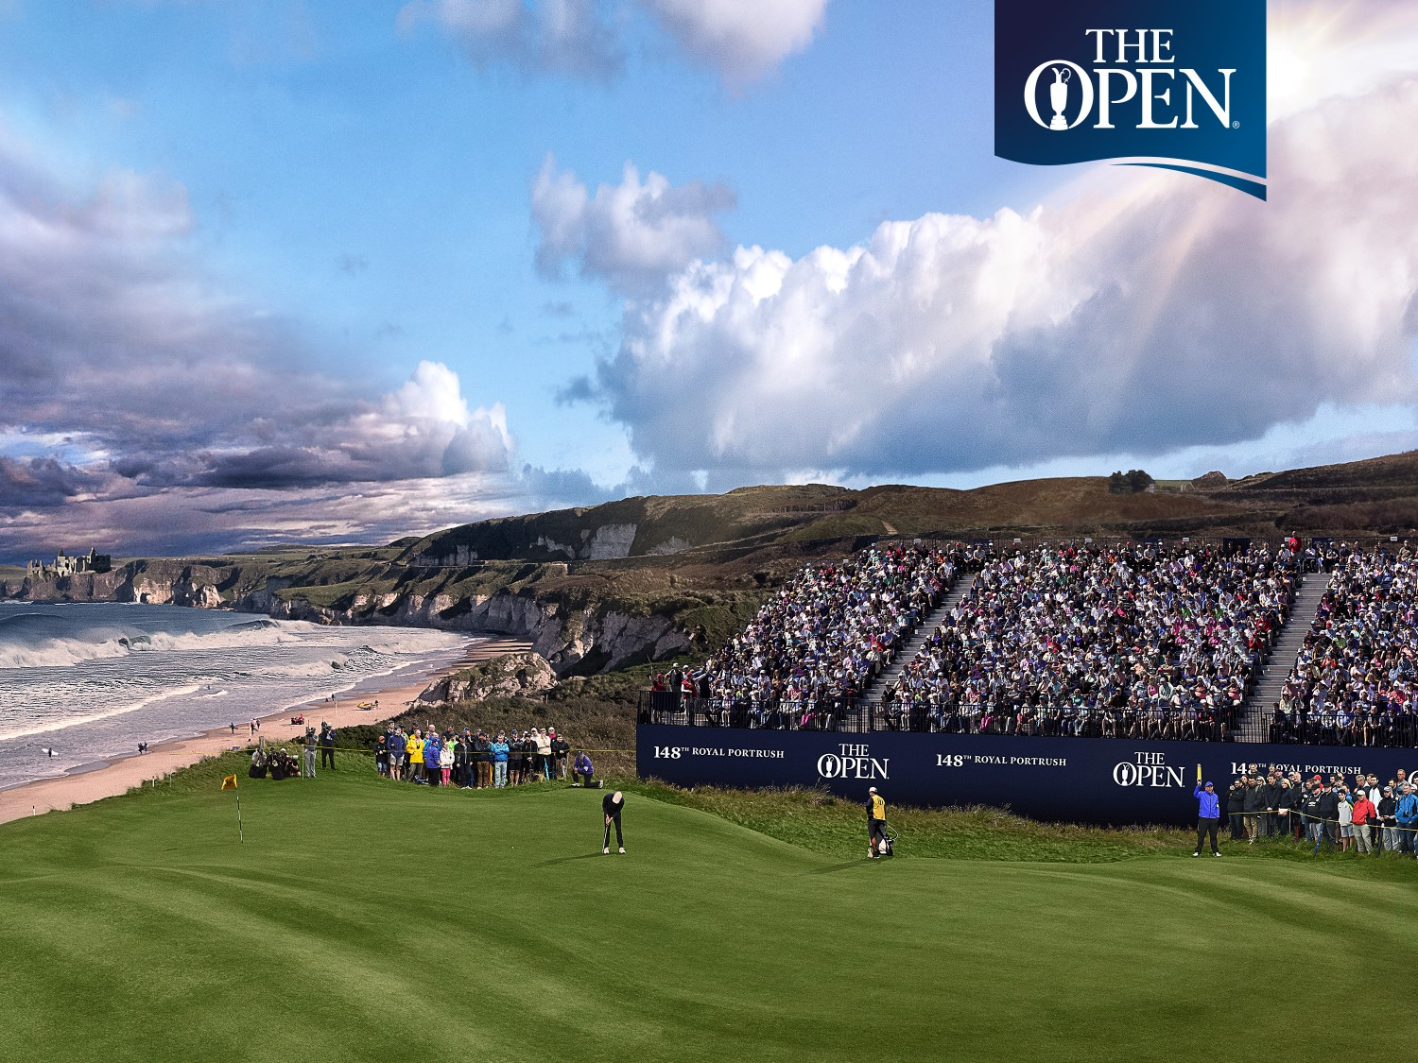
The 148th Open
Delivering a Lasting Legacy

Slide 2

The 148th Open Legacy Fund – Welcome
Richard Baker
Director
Causeway Coast and Glens Borough Council

Slide 3
The 148th Open Legacy Fund – Agenda
Welcome - Richard Baker (CCGBC)
Introduction to The Open Legacy Fund - Philip Russell (The R&A)
Application Process, Eligibility & Assessment - Patricia O’Brien (CCGBC)
Questions & Close

Slide 4

The 148th Open Legacy Fund – Introduction
Philip Russell
Assistant Director - Sustainability
The R&A

Slide 5
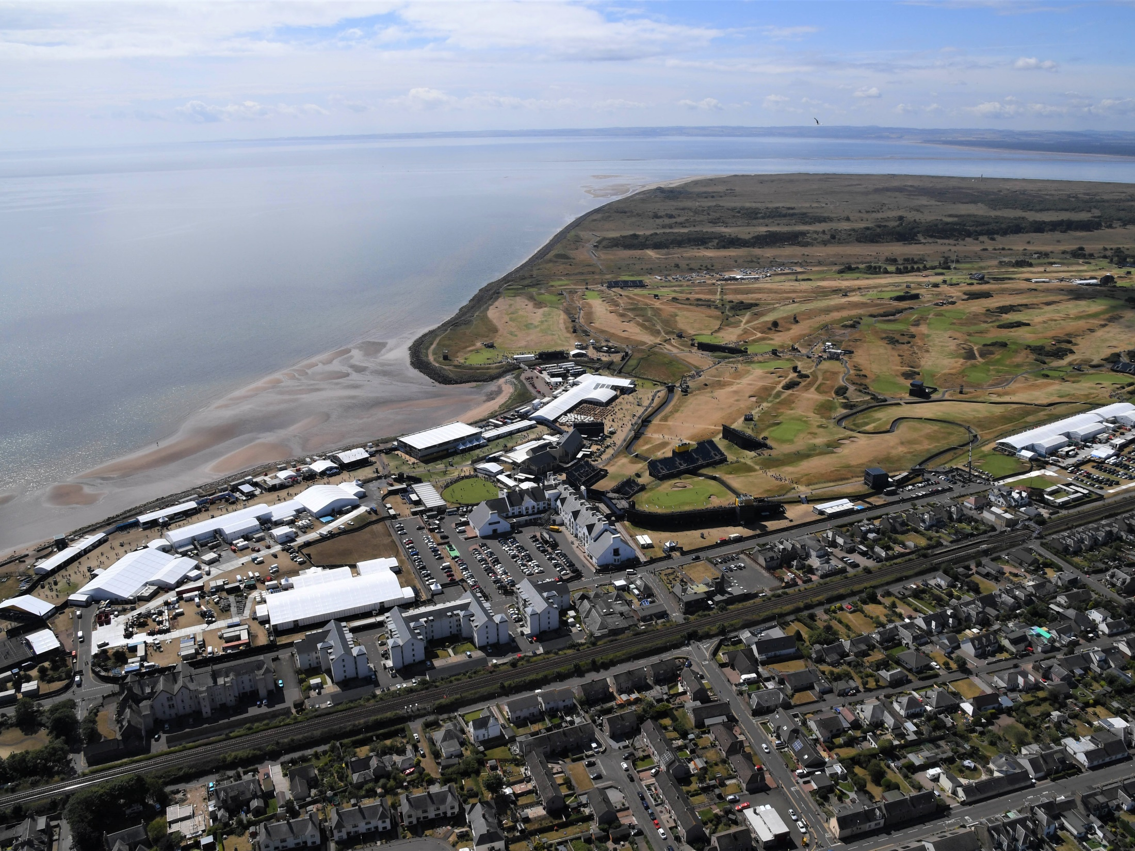

Slide 6
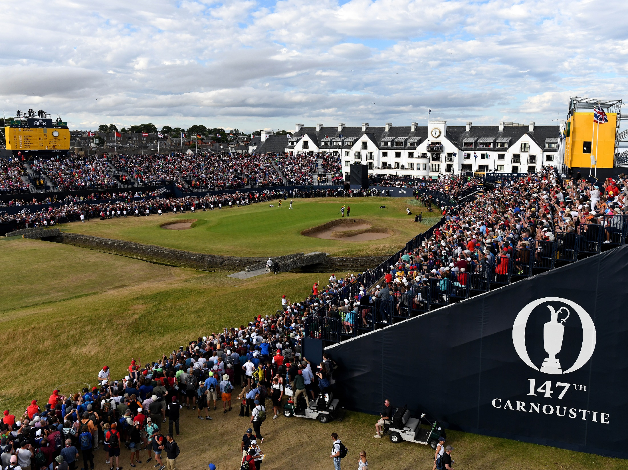

Slide 7
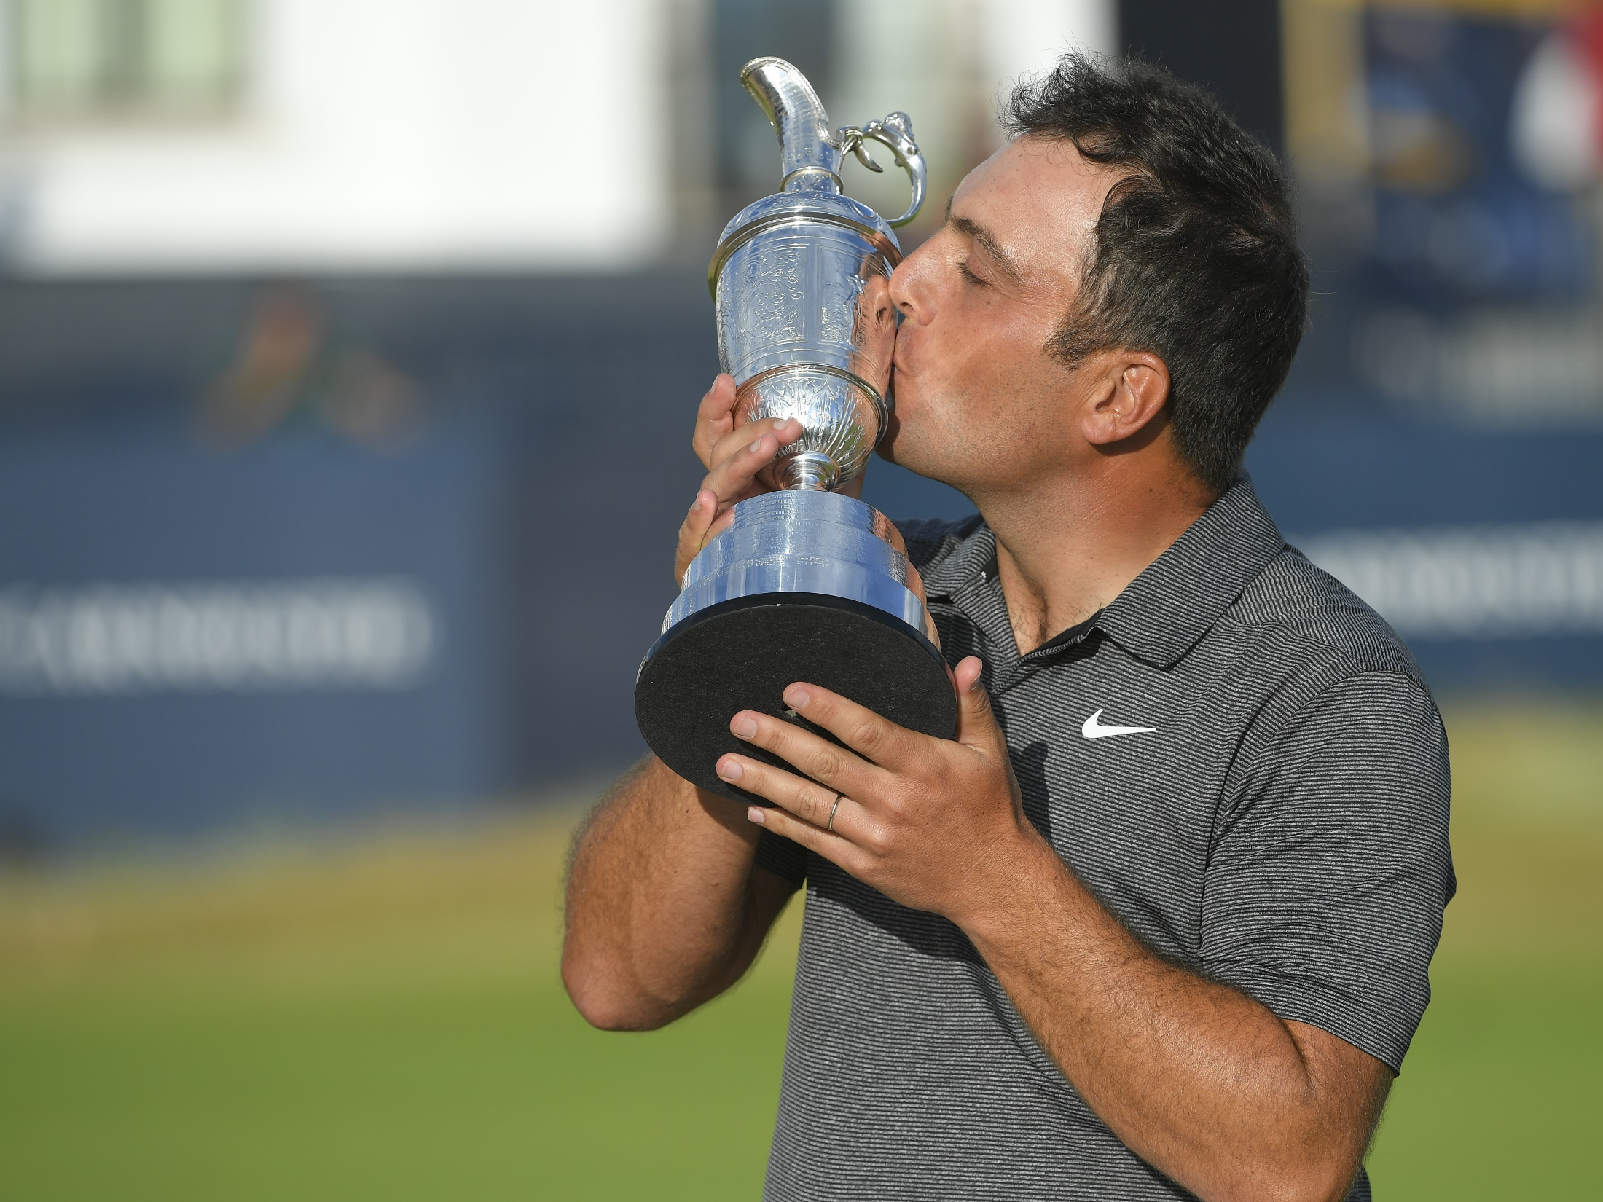

Slide 8
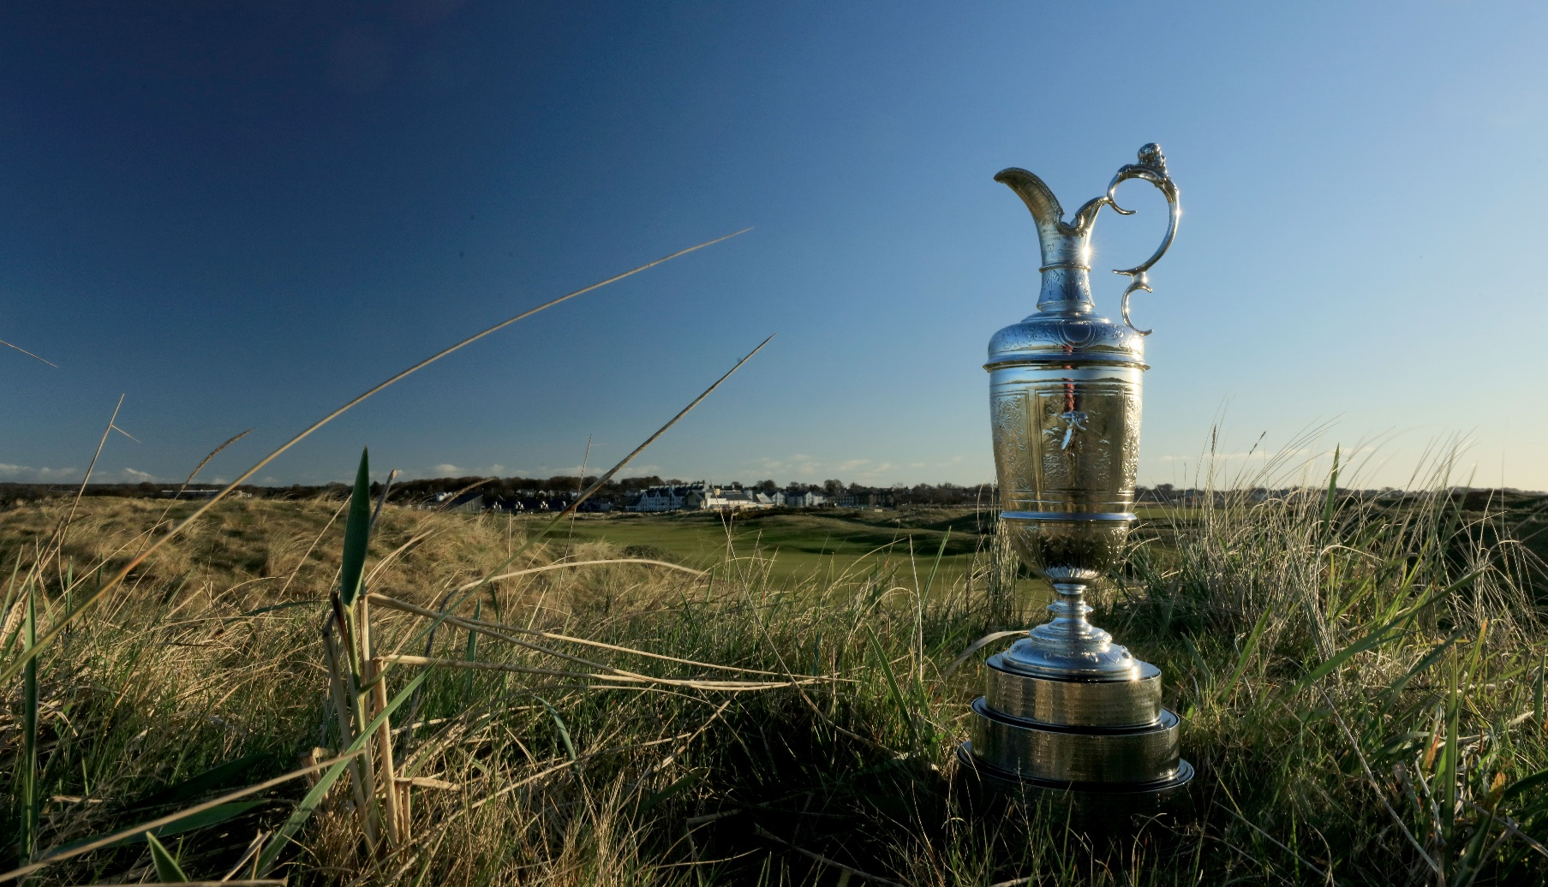
Delivering a lasting legacy

Slide 9

The Open as a driving force for sustainability in sport
Leadership
Innovation
Inspiration
Global showcase

Slide 10


Slide 11


A. Venue
  i. Club and course management
  ii. Site protection
  iii. Site restoration
B. Staging
  i. Procurement
  ii. Energy
    Temporary power
    Transport
    Travel and accommodation
  iii. Catering
  iv. Materials; reuse and recycling
  v. Community engagement
  vi. Safety management
C. Communications
  i. Media engagement and reach
  ii. Training and awareness
D. Partnership
  i. Patrons, Official Suppliers and Contractors
  ii. Local community; opportunity, involvement and benefit
  iii. Government
E. Legacy
  i. Advocacy and education
  ii. Projects
  iii. Industry standards

Slide 12
Delivering a lasting legacy
Projects do not have to be connected to golf but should be related to a sustainable development agenda.
The R&A will liaise directly with Causeway Coast and Glens Borough Council (as the host local authority) to discuss, review and select short-list projects.
The final decision on projects to receive funding will be made by The R&A’s senior management team.

Slide 13
Delivering a lasting legacy – examples from previous years

Slide 14
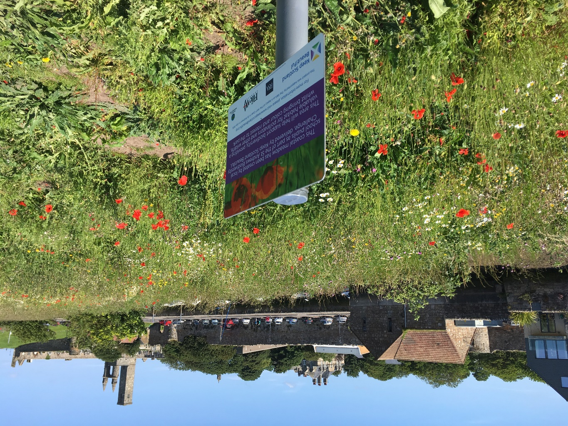
The 144th Open
St Andrews 2015

Slide 15
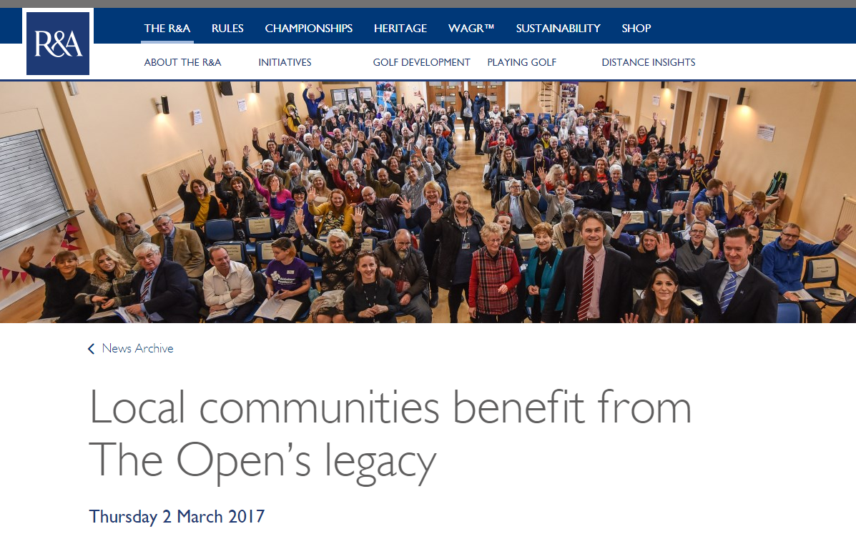
The 145th Open
Royal Troon 2016
https://www.randa.org/News/2017/03/Local-communities-benefit-from-The-Opens-legacy

Slide 16
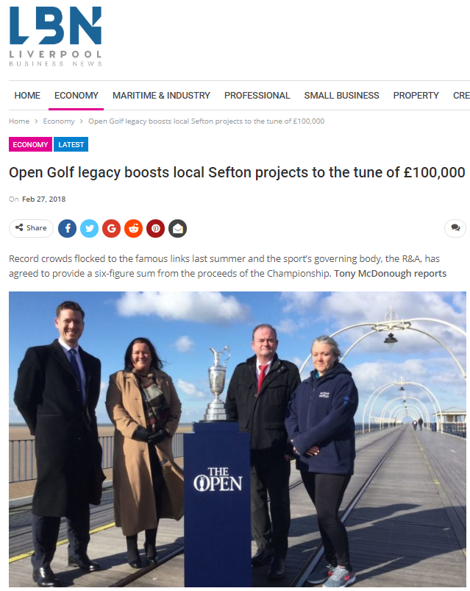
The 146th Open
Royal Birkdale 2017
https://lbndaily.co.uk/open-golf-legacy-boosts-local-sefton-projects-tune-100000/

Slide 17
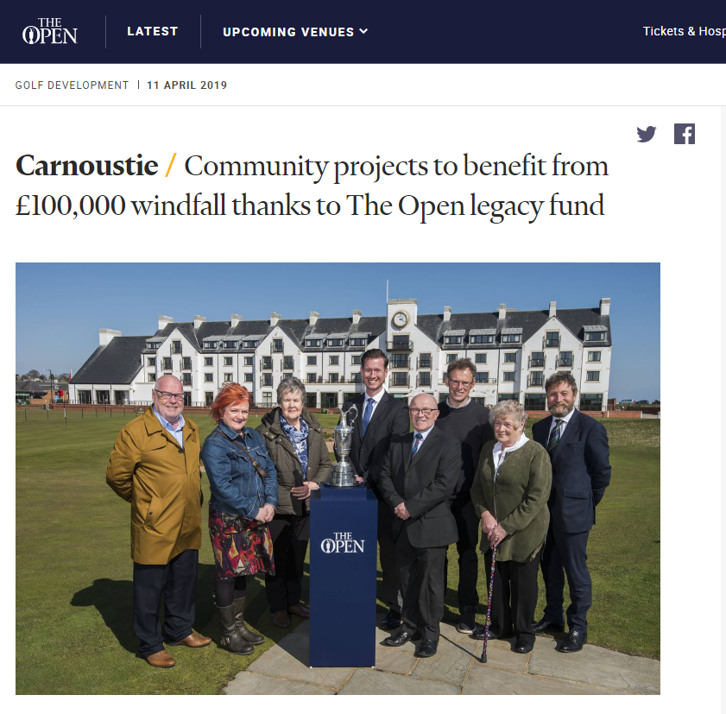
The 147th Open
Carnoustie 2018
https://www.theopen.com/latest/2019/04/carnoustie-community-projects-to-benefit

Slide 18
The 148th Open
Royal Portrush 2019
?

Slide 19
The 148th Open Legacy Fund – Programme Delivery
Patricia O’Brien
Funding Unit Manager
Causeway Coast and Glens Borough Council

Slide 20
Who can apply?
Properly Constituted not-for-profit Community & Voluntary Organisations and Statutory Organisations.
Applications where the beneficiaries are Portrush residents.
Only ONE application per organisation will be accepted.
Projects which can be completed with expenditure claimed before 31 March 2020.

Slide 21
The 148th Open Legacy Fund - Boundary Map

Slide 22
The 148th Open Legacy Fund – Levels of Grant Awards
Total Funds available are £100,000
There are two levels of grant awards available:
The 148th Open Legacy Fund Grant Programme | Maximum Grant Amount
Small Grants Large Grants | £5,000 - £10,000 £10,000 - £50,000
100% funding can be applied for
The R&A reserves the right to make the final decision on which projects receive support from The 148th Open Legacy Fund

Slide 23
The 148th Open Legacy Fund – Themes
Social | Environmental | Health & Well-being
Social may include: | Environmental may include: | Health & Well-being may include:
Projects which support and encourage children and young people to explore and use creativity to improve communication Projects which innovatively address the issues surrounding access for disabled and socially excluded people. Projects which address isolation and inclusion Projects which are creatively designed, harnessing new technology to create greater cohesion in the community. | Projects which support sustainable living Projects which promote sustainable food networks and sustainable farming Projects which create and promote opportunities to use sustainable transport solutions Projects which conserve and promote conservation of the natural environment and enhancement of biodiversity Projects which use and promote the use of renewable energy solutions. Projects which seek to protect and enhance the coastal and marine ecosystems Projects which involve the protection and promotion of our historic environment and heritage. | Projects which create greater awareness of the benefits of physical activity on health and wellbeing Projects which encourage and promote healthier lifestyle choices and behaviour Projects which promote good mental health Projects which enable vulnerable people to live as independently and safely as possible with the support of their families, friends and communities Projects which address issues surrounding access for disabled and socially excluded people to participate in physical activity.

Slide 24
How to apply?
Follow the link on Council’s Homepage:
https://www.causewaycoastandglens.gov.uk
Or ….. go direct to Council’s Funding Portal:
https://causeway.eformz.info
The Application Form is in two parts:
    Section A: Organisational Details
    Section B: Project Details
For guidance on answering questions, see Page 9 of Guidance Notes

Slide 25
Stage 1: Eligibility Assessment:
Every application that is received will be assessed for the following:
To ensure that the organisation is eligible to apply; and
    Has a properly adopted “Governing Document” such as a constitution or memorandum and articles of association which clearly show that it is non-profit making and taking
    Has a bank account in their own name
    Can submit proper accounts (most recent accounts must be provided)
To ensure that the project beneficiaries are Portrush residents
To ensure that any permissions have been applied for (Leases, Building Control, Planning Permission etc.)

Slide 26
Assessment & Scoring
Small Grants (£5,000 - £10,000)
All questions scored out of 5 and weighting applied
Applications scoring 65% or above will be considered for an award
In the event that the fund is oversubscribed, only the highest scoring applications will be selected
Large Grants (£10,000 - £50,000)
All questions scored out of 5 and weighting applied
Applications scoring 65% or above will be shortlisted for consideration.
Shortlisted projects will be considered by The R&A, who will then determine a final selection of projects who may be invited to publicly present at an event in Portrush. A public voting system will then be used to decide awards.
In the event that the fund is oversubscribed, the projects with the highest number of votes will be awarded funding.

Slide 27
Assessment Criteria
 | Criteria | Score (0-5) | Weighting | Max Points
1 | Project detail What will you do? When will you do it? Where will you do it? How will you do it? |  | X 4 | 20
2 | Identified Need How did you identify the need for this project and what evidence is there to support that? i.e. consultation with other stakeholders. |  | X 2 | 10
3 | Project beneficiaries? |  | X 2 | 10
4 | Project Outcomes (Community Cohesion + one other; Are the outcomes appropriate, measurable, has the applicant demonstrated how they will be achieved?) |  | X 4 | 20
5 | Ability to deliver the project outcomes |  | X 2 | 10
6 | Contribution to the themes: Social Environmental Health and well-being |  | X 2 | 10
7 | Marketing & Promotion (Is media content linked to The 148th Open Legacy Fund?). |  | X 2 | 10
8 | Legacy / Sustainability |  | X 2 | 10
 |  |  |  | 100

Slide 28
The 148th Open Legacy Fund
Deadline for Submission of Completed Application Forms:
12.00 noon on Friday 31 May 2019
https://causeway.eformz.info
https://www.causewaycoastandglens.gov.uk
Late applications will not be considered. No exceptions will be made and there is no recourse to appeal.

Slide 29
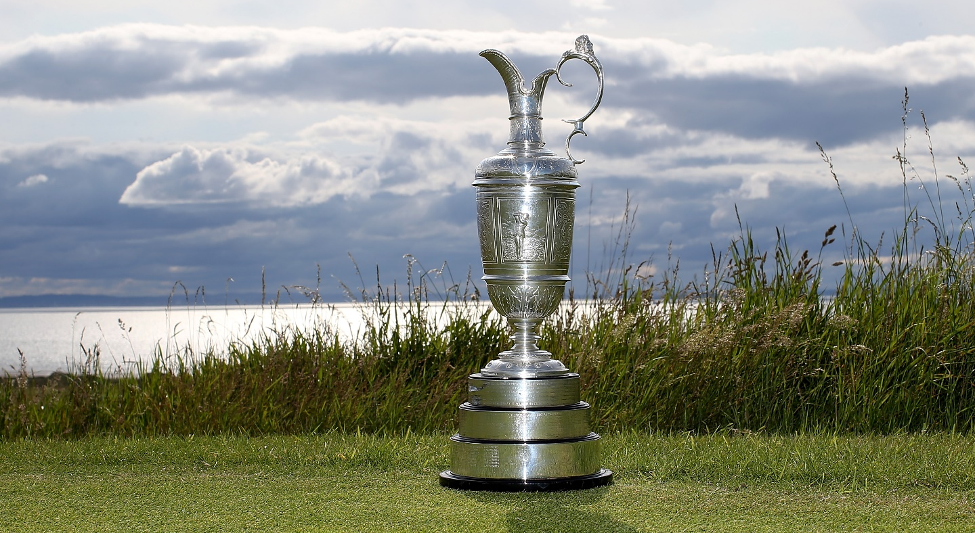
Thank you!
Any questions?

Slide 30
The 148th Open Legacy Fund – Close
Richard Baker
Director
Causeway Coast and Glens Borough Council

