Slide 1

Traffic, Transport and Parking
The 148th Open

Slide 2
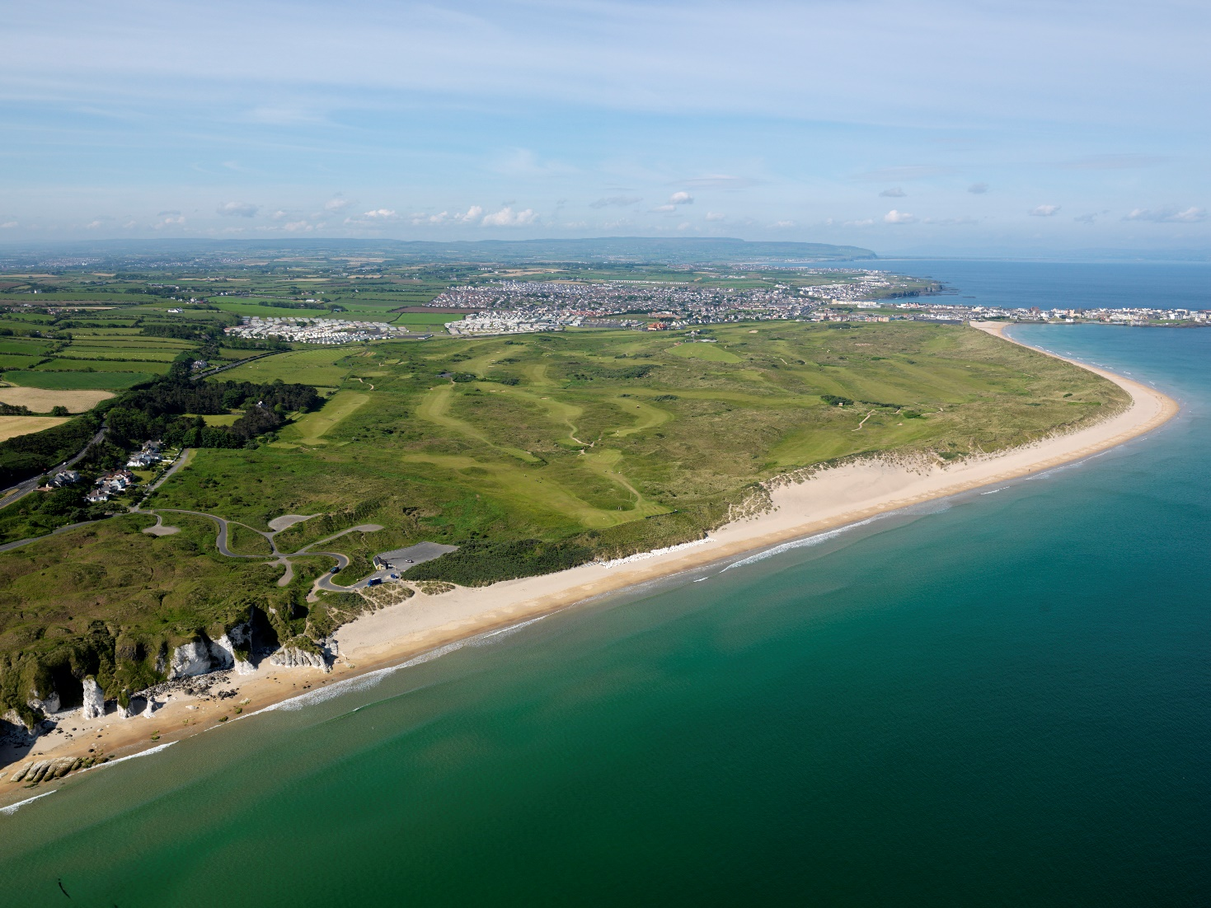
Traffic, Transport and Parking
Public Transport
Strategic Road Network
Park and Ride
Reserved Car Parking
Local Area Road Network
Non-Golf Related Traffic

Slide 3
Traffic, Transport and Parking
7000 reserved car parking spaces within 1km of RPGC.
14,000 park and ride parking spaces within 15min travel distance of RPGC.
90% of park and ride sites on grass.
Daily peak of 75 coaches and 75 minibuses.
The potential loss of the Catering College site.
Rail at 98% capacity during July.
Accommodate displaced residential parking.
Accommodate community and non-golf visitor car parking.

Slide 4
Traffic, Transport and Parking
Council – Chair
PSNI
Department for Infrastructure (Roads)
Translink
The R&A
Tourism NI
The AA
CSP
Northern Ireland Fire and Rescue Service & Northern Ireland Ambulance Service

Slide 5

Rail Services
Trains will travel ‘straight through’ from Belfast to Portrush.
All trains will double in size (3 to 6 carriages).
The number of morning and evening trains will increase.
The frequency of trains to and from Portrush will increase.
This amounts to approx 5000 additional passenger capacity per day.
‘Back-up’ Translink coaches positioned at Belfast, Antrim, Ballymena and Ballymoney providing an additional 1000 seats.
www.translink.co.uk

Slide 6
Bus Services
Goldline services from Belfast to Coleraine will be extended to / from Portrush.
The 140 service (Triangle) will operate at a 10 minute frequency and will stop at major caravan sites along the route to/from Portrush.
The 402 service (Ballycastle / Coleraine) will operate at a 30 minute frequency and will be extended to operate earlier in the morning and later in the evening.
The 134 service (Limavady / Coleraine) will be enhanced with details to be confirmed.
www.translink.co.uk

Slide 7
Road Access
Please note that there will be no spectator parking available at the course.
All spectator parking will be located at Park & Ride facilities.
Spectators will be directed to managed Park & Ride sites by Variable Messaging Signs (VMS) and AA event specific signs.
The PSNI will direct motorists to use the designated traffic routes, which will be clearly signed by The AA.
Spectators should turn off their satellite navigation systems.

Slide 8
Park and Ride
Located within a 15 min travel time from the course.
Translink will operate a max 10 minute shuttle service.
Managed by CSP, car park operator for the R&A.
Available to non-golf traffic – visitors to Portrush.
Designed to accommodate drivers and passengers with a disability.
Including motorcycle parking.

Slide 9
Local Road Restrictions
In accordance with the Road Traffic Regulation (Northern Ireland) Order 1997, access to the following roads will be restricted between the hours of 06:00 – 21:00 from Sunday 14 July – Monday 22 July 2019 (inclusive):
Bushmills Road – between Crocknamack Road and the Ballybogey Road.
Ballybogey Road - From Ballymacrea Road/Ballymagarry Road to Dunluce Road (Royal Court patrons will be facilitated).
Portstewart Road - Between Glenvale Crescent and Coleraine Road.

Slide 10
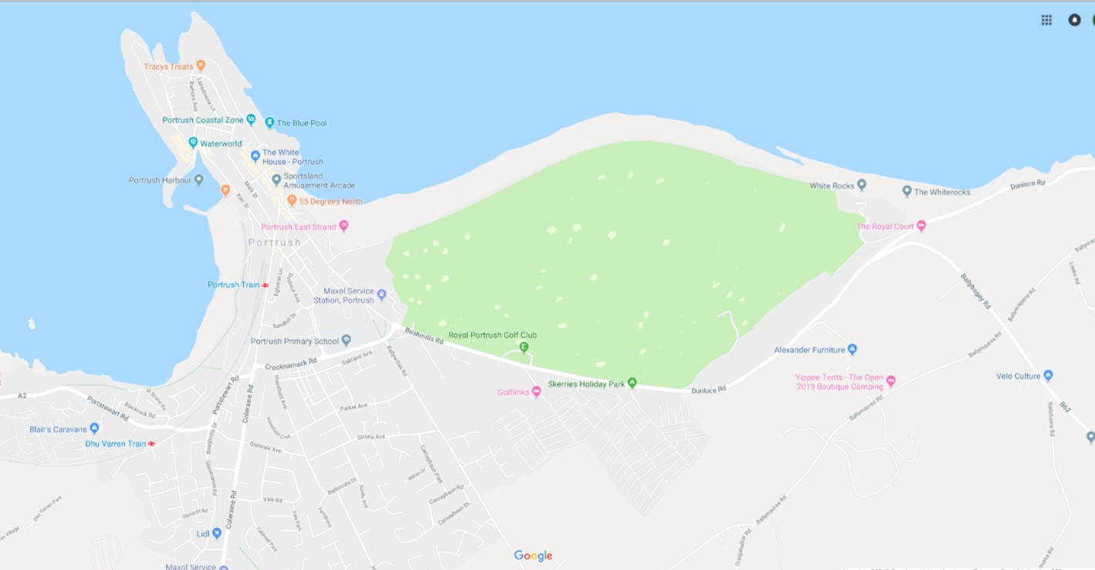

Slide 11
Local Road Restrictions
No waiting restrictions will also be in place on roads near the course.
Alternative parking will be provided for those affected by the restrictions who have no off-street parking available.
Residential and business access will be facilitated.
Taxi access will be permitted (specific access points).
Information detailing how to apply for permits will be issued to those affected by the restrictions in due course.

Slide 12
Other Event Specific Parking
Within 1km of the course, provision has been made for:
Translink Coach Parking – Sandhill Drive Car Park.
Private Coach Parking – Dunluce Avenue Car Park.
Minibus Parking – West Bay.
Taxi Drop Off and Collection – Metropole Site.
Helecopter Landing / Take-off site identified awaiting CAA approval.
Catering College site – discussions ongoing.

Slide 13


Slide 14
Non-event Car Parking
The following car parks will be available for general public use throughout the event:
  Lansdowne Car Park
  Lansdowne Green
  Recreation Grounds*
*A dedicated car park for local business owners and their staff will be established at the Portrush Recreation Grounds. Information on how to apply for permits will be issued in due course.
Further work is ongoing to facilitate access and parking throughout Portrush.

