Slide 2
Carolyn Boyd
Lesley-Ann O’Donnell
Tourism NI

Slide 3
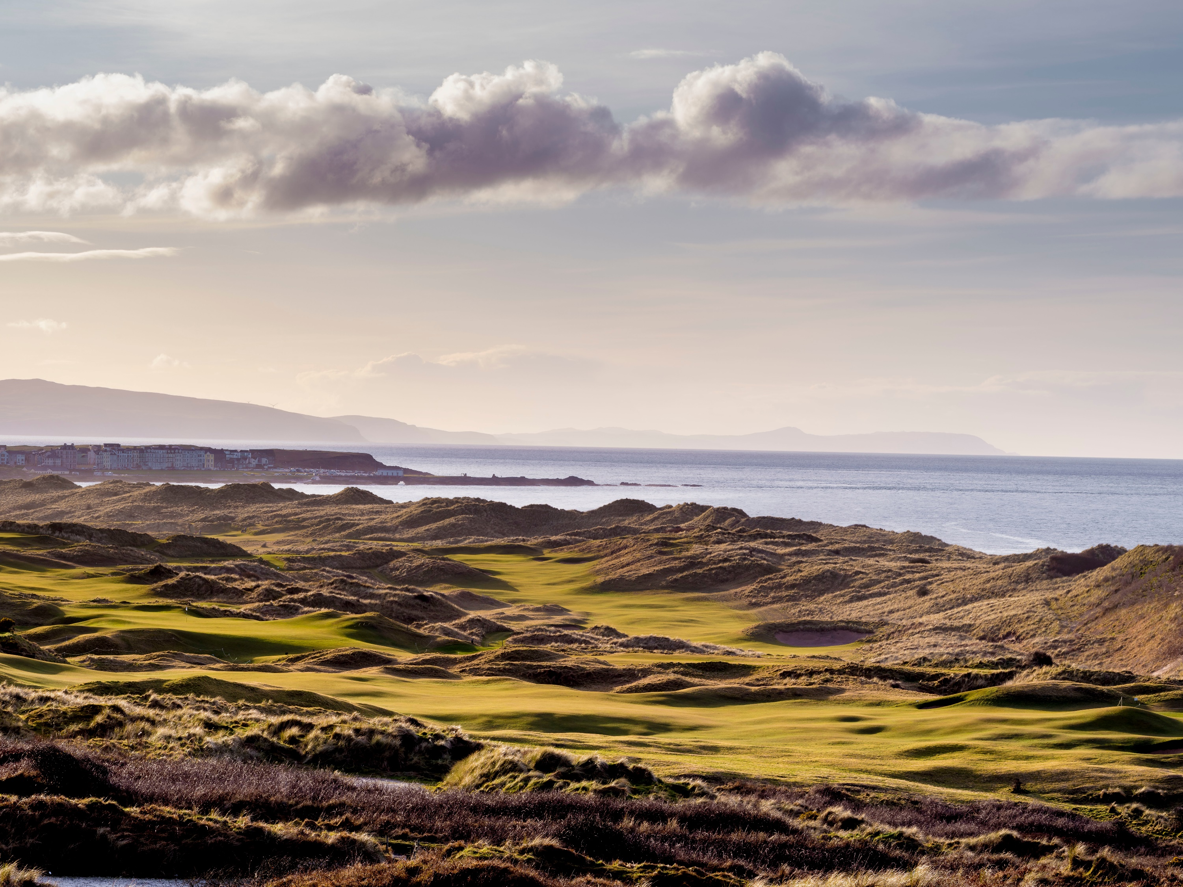


The 148th Open
Engagement Day

Slide 4

Introducing the 148th Open Toolkit
Carolyn Boyd
Industry Development Manager, Tourism NI
The 148th Open
Engagement Day

Slide 5
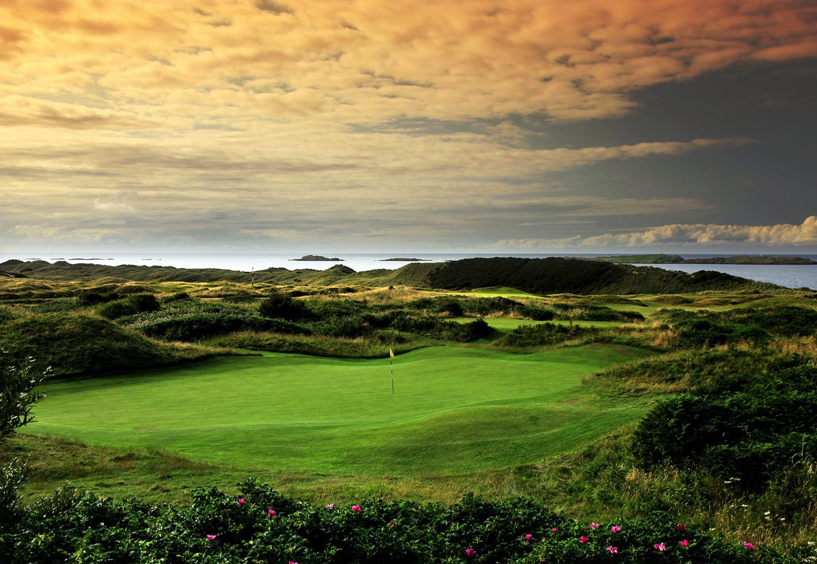


Are you ready for The Open?
Getting your business ready for The 148th Open

Slide 6
^{Get ahead of the Game}

Slide 7
Getting your business ready for The 148th Open
Northern Ireland is set to come alive from 14th to 21st July 2019.
For the first time since 1951 this event will take place in Royal Portrush.
We have cut our teeth on previous events such as The Irish Open but this promises to be something even more special.
Many golf visitors will experience our world-famous links and stunning parklands for the first time.
Our local celebrity players can’t wait to be back on home turf.
A chance to showcase all of NI as the fabulous destination it is.
Let us capitalise on NI’s recent Lonely Planet accolade.
Together Causeway Coast and Glens and Tourism NI
have developed top 10 tips to help you make the
most of every opportunity.

Slide 8
^{The Open in Numbers}
Over 190,000
Spectators and visitors
From across the world
£80 Million
Estimated economic benefit from hosting the event
500 Journalists from all over the world will be covering the event
Days of town centre activity while The Open is on
Over 150
Countries broadcast The Open
80 Million
Tv audience that watch The Open every year

Slide 9
TIP 1
Know all about it
Keep up to date and become an Open expert.
www.theopen.com/news
Know what resources are available.
www.theopen.com/spectators/advice
Talk to your staff.
Keep up to date with traffic and transport and events.
Nominate and invest in training an Open Ambassador.

Slide 10
TIP 2
Reach out to golfers
Respond to your customers needs.
Offer bespoke golf packages.
Display daily weather forecasts.
Prepare an early packed lunch.
Provide laundry/ drying room facilities.
Sign up for golfers Welcome Scheme. www.tourismni/welcomeschemes.
Provide an information sheet in the foyer.

Slide 11
TIP 3
Ambassador programme
Train Staff in WorldHost Ambassador Programme
Sign up to Volunteer www.volunteernow.co.uk.
Pre-order food to suit the needs of the customer.
Anticipate the needs of the golfing customer or ask them in advance.
Provide a locally sourced gift on arrival or departure.

Slide 12
TIP 4
Work together
Two heads are better than one.
What are the opportunities to work with other businesses or wider community?
Encourage spectators to watch The Open with you.
Work with your local Chamber of Commerce
Feedback ideas and support your local groups and networks.
Can the local College or University help with skills training for your staff?

Slide 13
TIP 5
International thinking
Golf is popular in The USA, UK, Ireland and a host of European countries.
Help international visitors sample local food and culture.
Make sure you are fully stocked with local information on things to see and do.
Give clear directions. We are small and accessible- sell that fact.
Do you have a language capability or can you translate a menu, directions etc.? Visitor information in languages is available from your local VIC.
Provide universal chargers.
Golf starts early so a breakfast on the go may be required.
Look at tee-off times
Is there an opportunity to source a local guide to give a truly authentic experience.

Slide 14
TIP 6
Shout about yourself
What do you want to say to your customers?
What do you want them to say about you when they leave?
Integrate messages about The Open into your communications.
Website www.theopen.com, Causeway Coast and Glens Website and discoverni.com
There will be an opportunity to create your own branded marketing materials. Keep up to date with changes on TNI’s media library.
There will never be such media attention on all of Northern Ireland. Positive PR could really help your business.

Slide 15
TIP 7
Be Open ready
Have t-off times at hand.
Catch your early risers.
Keep abreast of transport plans to make sure you, your visitors and your team can get in and out of the area.
Work out the finer details of your offers. Are you competitive, providing value for money compared to others?
Are there opportunities to add value through partnerships?
Will guests stay longer and spend more in the area?

Slide 16
TIP 8
Come again
70% of visitors will return again.
Maximise NI’s Lonely Planet accolade.
Do your own research on what your customers want.
Sell the destination beyond the golf.
Game of Thrones/Food Experiences/Literature
Could you provide suggested itineraries with “Money can’t buy” experiences?
Use translation services- They are FREE.
Gather data on your visitor so you can meaningfully reach them after the event to lure them back.

Slide 17
TIP 9
Get online
Update your website and link to other partners.
Highlight on social media clearly what you are doing to be “Open Ready.”
Are you using the correct Hashtag? #theopen
Vary your messaging to keep visitors interested and engaged.
Share items such as menus, itineraries etc.
Show your business as a hive of activity and you will attract more visitors.

Slide 18
TIP 10
Marketing protocol
Get dressed for the occasion.Use the NI Made for Golf branding by accessing all the assets available.
Who are our Golf Visitors?
What other Golf and local events are going on? Be sure you are up to speed and share these.
Know the 19th Hole. Local Bars, Restaurants, Shops, Attractions and Tours
Discoverni.com golf section will allow you to promote your services. tidi@tourismni.com
Get familiar with Tourism Irelands Industry Opportunities at www.tourismireland.com/industryopportunities.

Slide 19
Dos
Use general references to golf and factual statements relating to the event.
For example, ‘welcoming The 148th Open’
Create displays and signage (in line with relevant consents) that have a general association with golf. For example, you could use golf balls or golf clubs and have some fun with it!
Comply with any existing advertising consents and regulations
Make use of available resources and materials to show your support
Consider event-related promotions specifically for the duration of The Open

Slide 20
Don’ts
Use any wording or undertake any activity that creates an impression of an official association with The Open or The R&A. For example, ‘in association with’, ‘sponsored by’, ‘official’.
Use any official trademark relating to The Open, or anything that could be mistaken for a trade-mark. This includes the use of words as well as logos or marks
Try to gain any commercial advantage by suggesting an association with The Open or any endorsement from The R&A – unless that exists
Display advertising that does not have the required consents
Mislead customers into creating an association with The Open or The R&A where none exists.

Slide 21
^{Useful Links}
^{www.theopen.com/news}
www.discovernorthernireland.com
www./tourismni.com/theopen/
^{Information for Your Staff}
www.volunteernow.couk/volunteering/volunteering-at-events

Slide 22
Ready to tee off?

