Slide 1
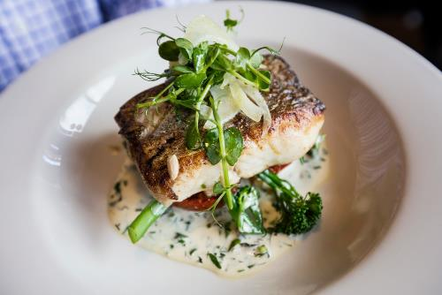
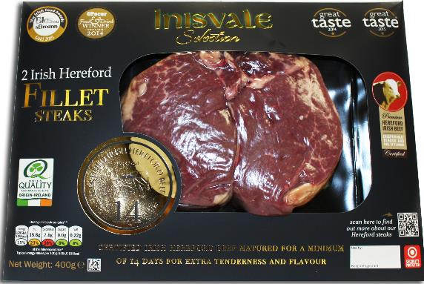
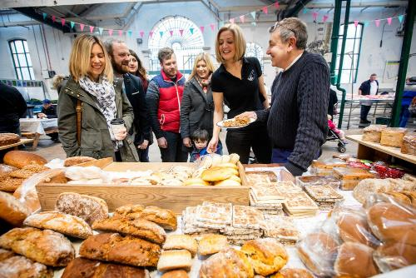
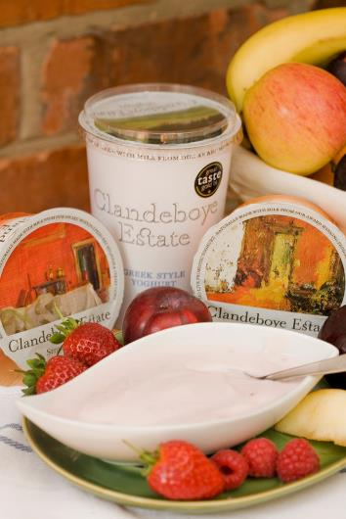
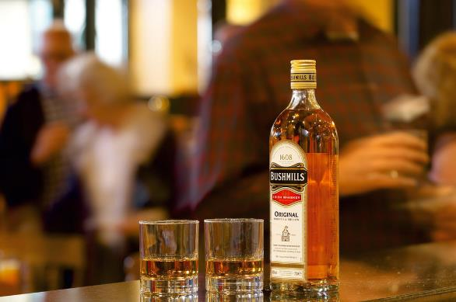
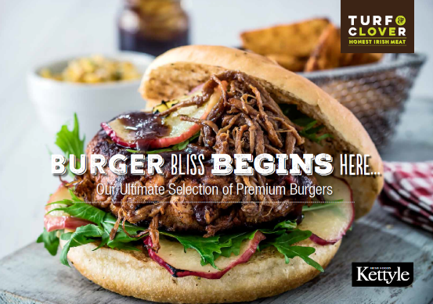
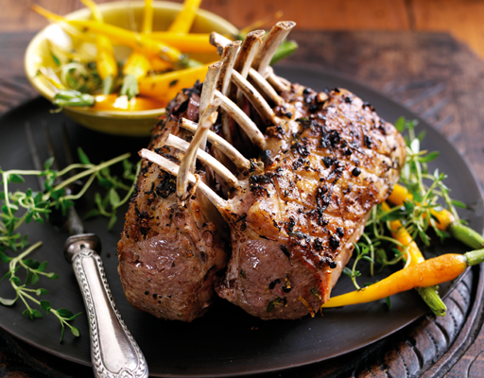
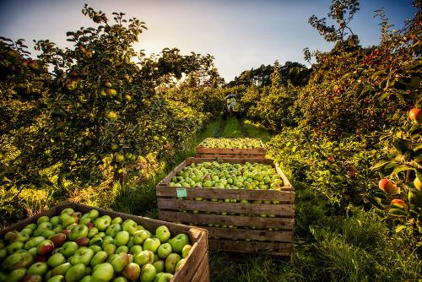
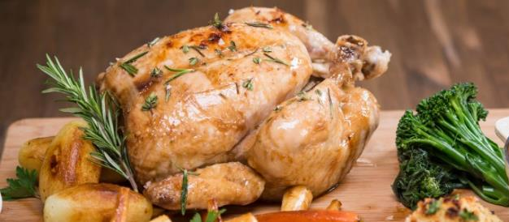

Invest NI Food & Drink Division

Slide 2
4 teams: - Food Strategy, Drinks & Horticulture - Meat, animal Feeds & Animal By-Products - Dairy, Bakery, Fresh Produce & Convenience - Food Business Development & Foodservice
John Hood Director
Peter McArdle Strategy, Drinks & Horticulture
Gráinne Moody Meat, Animal Feeds & By-Products
Andrew Horne Dairy, Bakery & Fresh Produce
Nigel Hardy Food Business Development
Fiona Walker
Damien McLoughlin
Alastair Higgins
Chris Bannon
Amanda Gamble
David McGrath
William Magee
Thelma Fitzgerald
Eddie Hamill
Michelle Charrington
Karl Devlin
Drew McIvor
Jen Guiney

Slide 3
Working with all Food Processing Sectors, across Key business areas
10 subsectors:
Supporting businesses across key areas:
Milk & Milk Products
Beef & Sheepmeat
Poultry meat & Eggs
Drinks & Beverages
Animal Feeds
Animal By-Products
Pigmeat
Bakery & Convenience
Fruit & Veg & Hort
Fish
Starting a Business
Starting a High Growth/Business
Finance
Growing Your Business
Skills Development
Maximising Efficiencies
Supply Chain
Leadership & Coaching
Product Development
Design
International Trade & Investment
Export Market Research
Advice & Info
Business & Marketing Strategy
Property
Finance
Energy & Waste
ICT & eBusiness
Operating Improvements
IP
Technical Advice
Collaboration
R&D
Marketing & Sales
Trade Visits & Exhibitions
Locate in NI

Slide 4
What we do
Financial Support
We work with businesses which are ambitious, want to grow in export markets, can generate jobs and plan to undertake R&D. We actively work with businesses which can meet the following criteria:
Invest NI’s Food Division works with over 300 food and drink processing businesses, helping them to increase productivity and generate sales, to export outside of Northern Ireland, to undertake R&D, to expand into new markets and to create jobs.
We offer a wide range of financial and advisory support, and signpost to other relevant organisations.
We engage with third party food-related organisations such as Northern Ireland Food and Drink Association, Food NI, the Livestock and Meat Commission, Northern Ireland Meat Exporters’ Association, and government departments such as Department for the Economy (DfE) and the Department for Agriculture, Environment and Rural Affairs (DAERA).
The Food Division has its own dedicated Food Business Development Team covering Great Britain, the Republic of Ireland, Europe and the Middle East/Rest of World. There is also a dedicated Trade Team for food and drink in Invest NI.
Growth Potential
[Potential Employment Growth ≥20% or ≥20 jobs within 3 years] OR
[Potential External Sales Growth ≥20% or ≥£500k within 3 years] OR
[Potential Increase in GVA / Employee ≥20% within 3 years]
Actual External Sales ≥25% or £250k pa
Actual Turnover ≥£250k pa

Slide 5

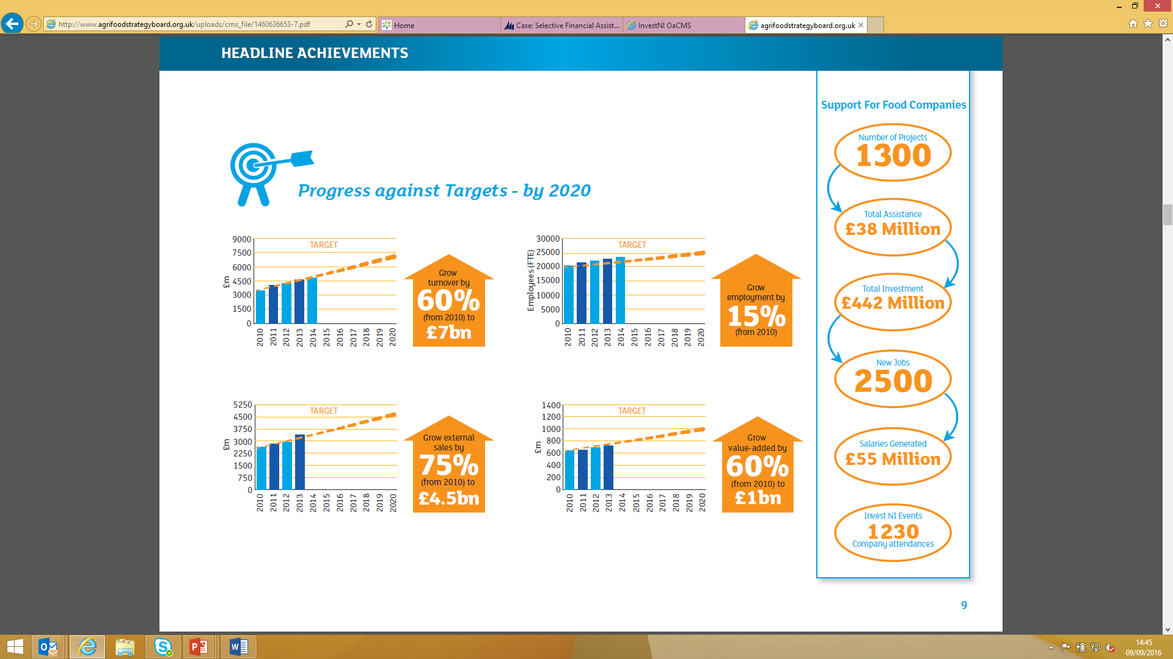
Headline Achievements (AFSB Delivering Growth Update March 2016)

Slide 6
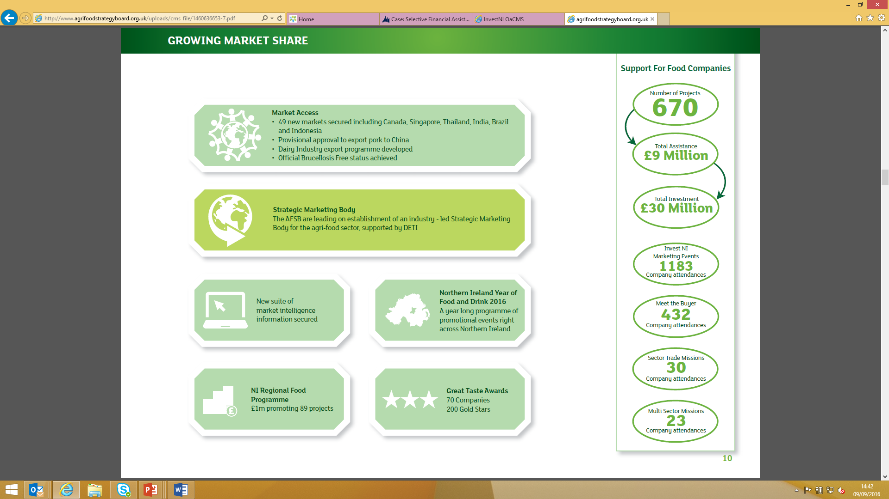
Growing Market Share (AFSB Delivering Growth Update March 2016)

Slide 7
Growing Market Share

Slide 8
Invest NI’s Marketing & Trade Support for food & drink
The Food & Drink industry has a dedicated business development team to help our customers grow sales in markets outside of Northern Ireland.
Access to Buyers
In-market advisors in ROI and GB – facilitating access to buyers in market
‘Pay as you go’ advisors in France, Italy, Spain and Germany
Online sales promotion via www.buynifood.com
Ongoing PR and media campaigns
International Business Team
The team promotes and markets NI food and drink businesses in ROI, GB, Europe, Africa, Asia and America.
Trade
Our trade team helps food and drink businesses make their first steps into export markets, expand their export sales and undertake research on new markets and/or customers.
We support our customers to undertake market visits, attend exhibitions and undertake trade missions with us or on their own.
We organise trade visits, missions, capability and sector stands at a wide range of shows specific to the food and drink industry.

Slide 9
Food Exhibitions
Invest NI helps its food and drink customers to participate on its programme of food and drink events. Our calendar of activities from January to March 2017 is:
Food and drink businesses can also participate on Invest NI’s multi-sector shows.
Month/Year | Event | Location | Type of Event
21 – 23 February 2017 | Catex | Dublin | Exhibition
26 February – 2 March 2017 | Gulfood | Dubai | Exhibition

Slide 10
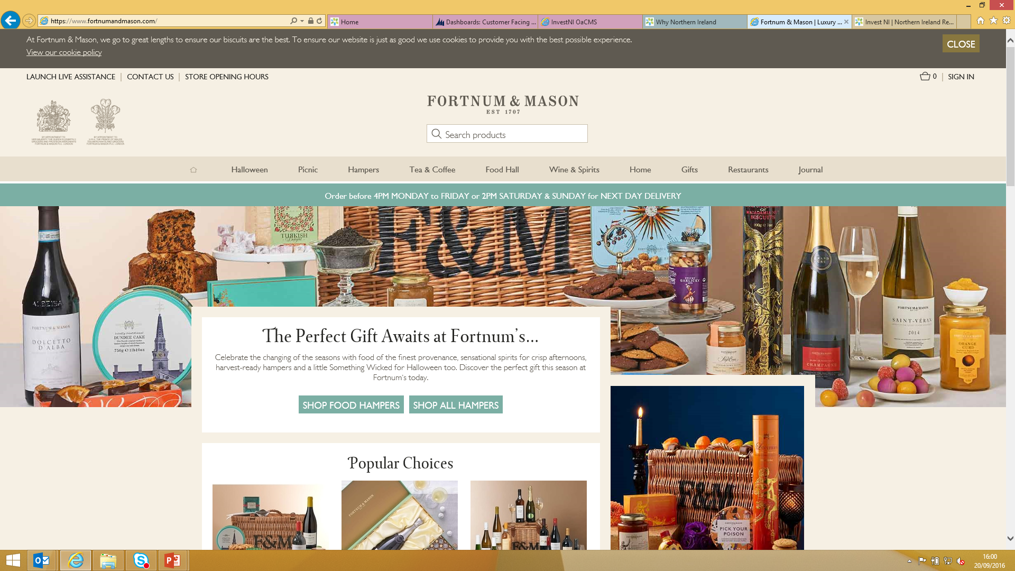
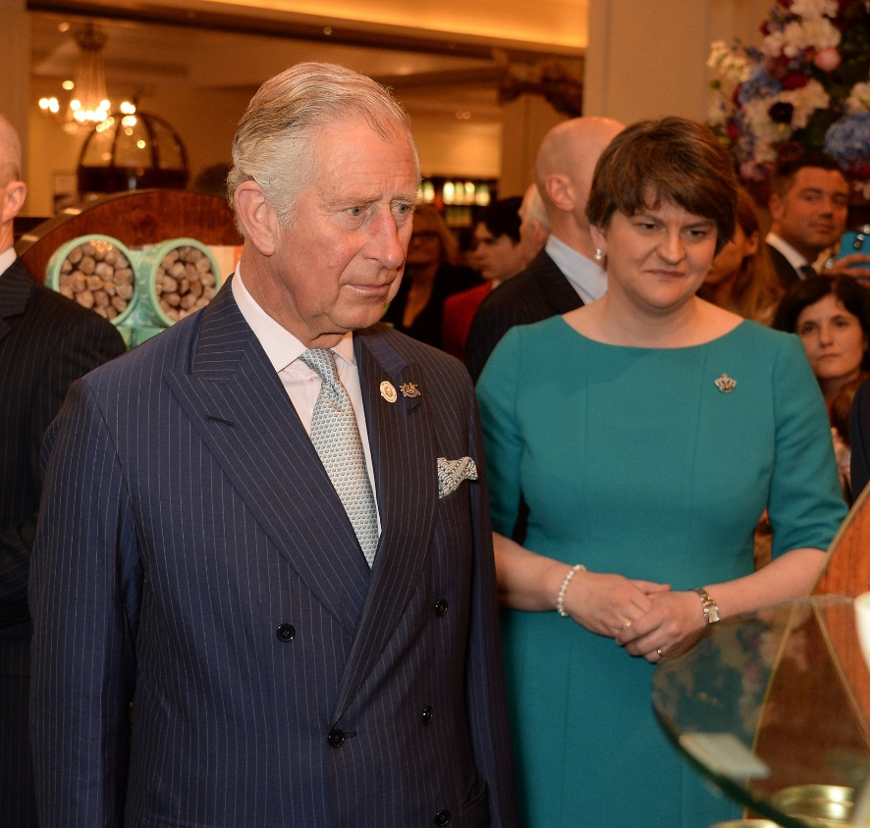
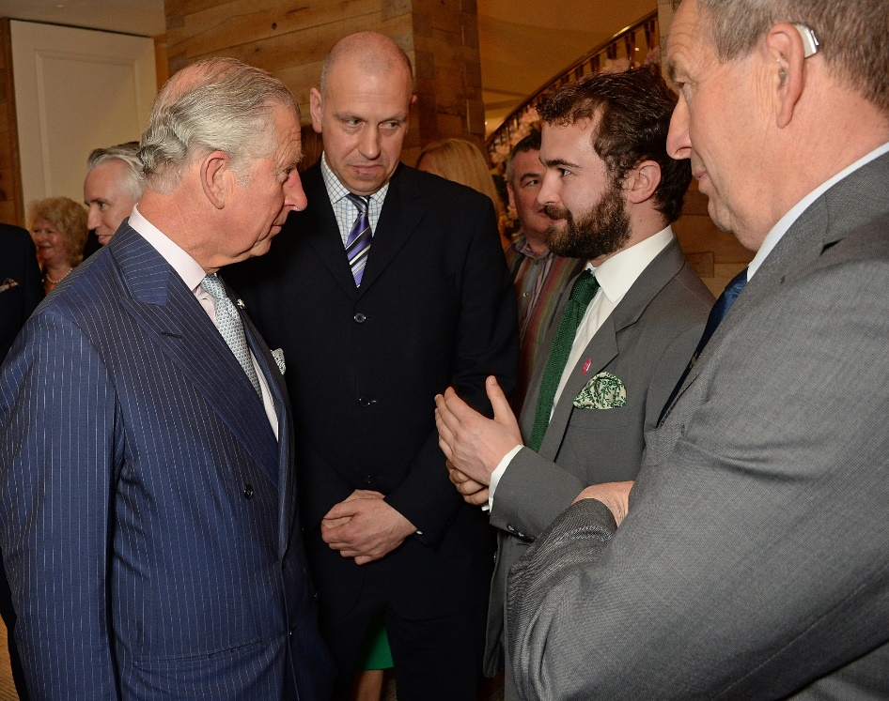
Fortnum & Mason
Northern Ireland Food and Drink was in the spotlight in London at Fortnum and Mason’s Taste of Northern Ireland promotion from 5th – 19th May 2016 at its Piccadilly store. Artisan beer, award-winning cheese and exquisite meats are among the 42 products on offer at the iconic business, famous for bringing the finest food and drink to its customers from all the corners of the world. Organised in partnership with Invest NI, the 23 businesses invited by Fortnum and Mason had the opportunity to meet Prince Charles along with influential buyers, customers and suppliers at London’s premier food and drink retailer. Ewan Venters, CEO of Fortnum and Mason said “Northern Ireland boasts an abundance of world-class produce and we are delighted to host this London platform for Northern Ireland’s Year of Food and Drink celebrations. The quality of everything is astounding and we know our customers are going to fall in love with the Northern Irish food on offer.”

Slide 11
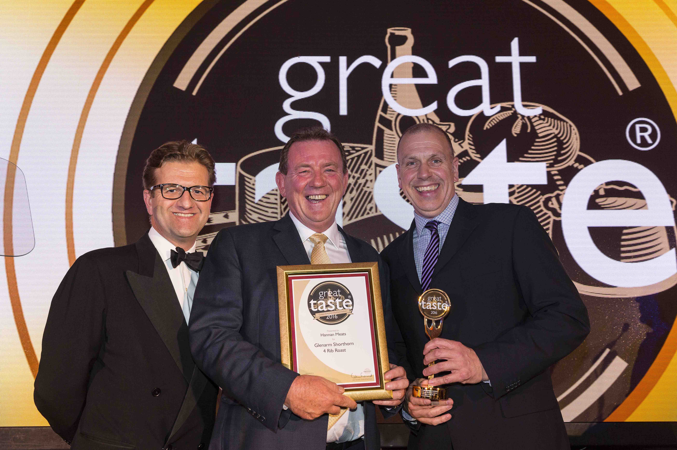
GREAT TASTE AWARDS
From 10,000 entries in Great Taste 2016, the prestigious honour of Great Taste Supreme Champion 2016 has been awarded to Hannan Meats’ Glenarm Shorthorn 4 Rib Roast. Hannan Meats is the first producer in the 22-year history of Great Taste to take the top award for a second time. Produced in Armagh, Northern Ireland, this exceptional piece of beef is dry-aged in a Himalayan Salt Chamber for a minimum of 28 days. Great Taste judges heaped praise on its outstanding flavour and succulence.
The Supreme Champion award, which is sponsored by Harrods, was presented to Peter Hannan at the Great Taste Golden Forks Dinner held on Monday 5 September at the Royal Garden Hotel in Kensington, where over 300 guests from the world of fine food gathered to hear the results of many months of rigorous judging.
“It’s a unique year for Northern Ireland food and drink. The 212 local products rewarded with the UK Guild of Fine Food’s valuable independent validation of taste and quality present an important and fitting showcase of the pure, natural quality of our produce.”
In July, 13 local products from eight companies were awarded the highest accolade of three gold stars in the prestigious annual event organised by the influential UK Guild of Fine Food. Eighty four local companies also secured almost 303 gold stars.

Slide 12
Invest NI and the
The Agri-Food Strategy Board (AFSB) was appointed by the DETI and DARD Ministers in May 2012, comprising an independent Chair from industry, eight industry members representing both the primary and processing sectors of the industry, and four senior public servants from DETI, Invest NI and DARD.
The Agri-Food Strategy Board’s Strategic Action Plan, ‘Going for Growth’, was launched in May 2013 at the Balmoral Show by the First Minister and Deputy First Minister, with the DETI and DARD Ministers.
The Action Plan outlines a path for the development of the industry to 2020, containing 118 recommendations across seven cross-cutting themes and 10 industry sectors. A substantial number of these recommendations are currently being developed and/or implemented.
The seven themes are: i) Growing Market Share; ii) Working Together; iii) Sustainable Growth; iv) Innovation, Entrepreneurship and Skills; v) Better Regulation; vi) Financing Growth; and vii) Food Fortress.
Invest NI works with the AFSB and industry on the implementation of this strategy, in partnership with other Government Departments, to help create the agri-food industry of the future.
Invest NI contacts for further information on the strategy are Peter McArdle (028 9069 8414) & Fiona Walker (028 9069 8787).

Slide 13
Importance of the food and drink sector to Northern Ireland
Northern Ireland’s biggest manufacturing industry (accounting for 25% of manufacturing sales)
NI’s biggest manufacturing employer (26%)
Accounts for most manufacturing sales outside of NI (23%)

Slide 14
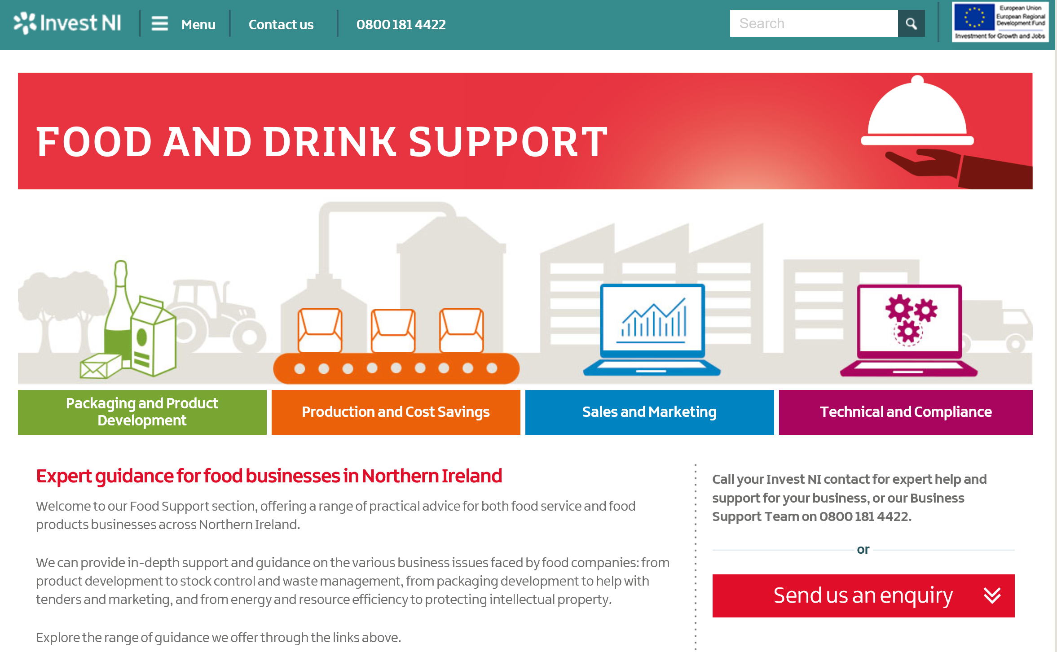
Guidance for food & drink Businesses: www.investni.com/food-and-drink-support.html

Slide 15








Recent Success stories
.
The Meat Merchant owned by Peter Hannan was named ‘Supreme Champion’ in the 2016 UK Great Taste Awards.
The company achieved 36 product awards at the 2016 Great Taste Awards.
Dale Farm has opened a new cheese retail packing facility at their Dunmanbridge facility near Cookstown, with assistance from Invest NI, with a focus on growing cheddar sales both in domestic & export markets.
Just Live A Little, secured their first business in Sweden, after participating on an Invest NI trade mission.
The family run business has been proactive in looking for new markets & this deal follows on from earlier successes in Germany, Asia & UAE.
Tayto Group Ltd & Irwin’s Bakery have both secured new orders in China, after participating at the 2016 Food Hotel China exhibition.
Irwin’s has secured a valuable order with United Merchant Food in Beijing, while Tayto NI has shipped its first 2 orders to China.
Echlinville Distillery has launched a new Single Estate Irish Pot Still Gin. The drink gin is the first spirit intrusted to carry the distillery name. The company already has pre-orders locally & across Europe. The distillery hopes to follow the export success of its Dunville’s Irish whiskey brand by working with their American importer to launch the gin in the USA.
Finnebrogue Artisan has opened its new premises, which include a café, a food development centre & creative kitchen, with support from Invest NI.
The company plans to use the additional capacity to build upon its success in terms of new product development & sales outside NI.

Slide 16

For more information contact:
Dairy Bakery Drinks Poultry Redmeat Pigmeat Fish
Horticulture Fruit Vegetables Animal By-Products Strategy
Policy Dairy Bakery Drinks Poultry Redmeat Pigmeat Fish
Horticulture Fruit Vegetables Animal By-Products
Food & Drink Division
Invest Northern Ireland
Bedford Square
Bedford Street
Belfast
BT2 7ES
Direct Tel: +44 (0) 28 9069 8000 or +44 (0) 28 9069 8083
Email: amanda.gamble@investni.com
www.investni.com www.nibusinessinfo.co.uk www.buynifood.com
Text Relay Number: 18001 028 9069 8083
If you are calling using a textphone from outside the UK please call: +44 151 494 1260 028 9069 8083

