Slide 1
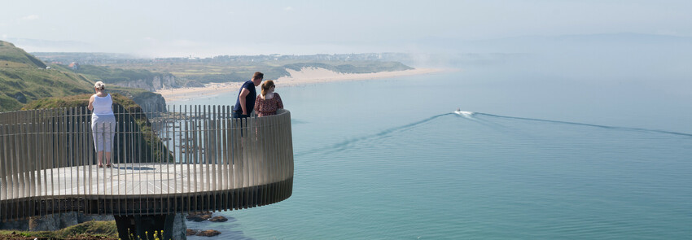
Causeway Coast and Glens Borough Council
Spring Economic Forecasts 2022

Slide 2
Contents
Northern Ireland
    Context & historical trends
    Economic outlook
Causeway Coast and Glens Borough Council
    New data insights for the local economy
    Performance and economic outlook
  Concluding Points
  Appendix and Glossary
2

Slide 3
Introduction
The Spring 2022 Outlook is based on an expectation that the strong recovery seen in the latter part of 2021 will continue into 2022 but that it will be accompanied by higher levels of inflation and cost of living pressures than we have seen in a decade and more.
As the pandemic supports for businesses and incomes provided by Governments (eg: furlough, SEISS, back to business grants and rates holidays) have come to an end, this Outlook focuses more on the nature of the recovery and some of the issues that might arise in the next few years. To assist your thinking in this we have also included a special section on new datasets that can provide an ongoing picture of the labour market and incomes.
The two scenarios for the Spring 2022 Outlook have the following assumptions:
Baseline – Assumption that the recovery will see the value of GVA returning to pre-COVID levels in 2022 and employment rates by next year.
Upper – This scenario assumes an additional 76,800 jobs being created within the economy over the 2022-2030 period. Employment is also expected to exceed pre-covid levels in 2022.

Slide 4
Northern Ireland
Contexts

Slide 5
Strong growth but with costs and downside risks
Unpredictability and uncertainties remain to the fore
The signs of growth...
Recovery in economies globally has been stronger than first expected
Steady progress in managing the pandemic health impacts
Strong and continuing consumer demand including tourism
All sectors seeing vacancy levels and tightness in labour supply
with some costs and risks
Uneven return to ‘normality’ at a global level and will be impacted by events & trends
Inflation issues will continue this year & probably into 2023
COVID will continue to have travel impacts
Demographic trends unlikely to provide a strong labour supply

Slide 6
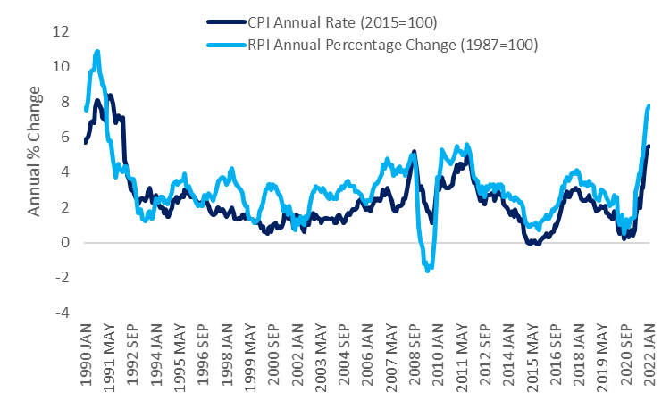
UK Inflation trends
Inflation increasing significantly since the end of 2021
UK Inflation, CPI and RPI, 1990 – 2022
Source: ONS

Slide 7
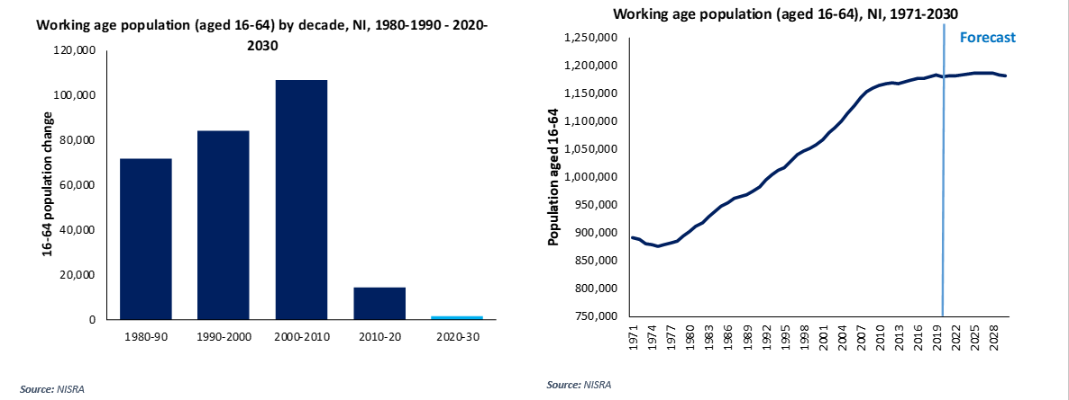
Demographic changes on the horizon
NI wide decline in working age population growth
The growth in Northern Ireland’s working age population is slowing with only 3,000 additional 16-64 year olds expected between 2020-2030. This has major implications for filling vacancies and wider employment expansion. On the other hand, in ROI the 16-64 y.o. pop is expected to grow by 259k.

Slide 8
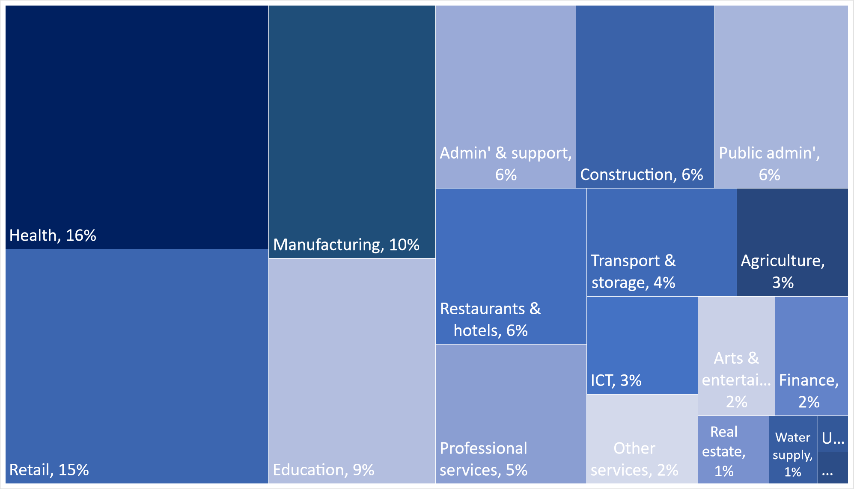
Health & social care & retail, NI’s largest sectors
Sectoral employment, % share of total employment, NI, Q3 2021
Total employment Q3 2021:
884,400
Elect' & gas: 0.3%
Mining: 0.2%
Source: Workforce Jobs & UUEPC Analysis

Slide 9
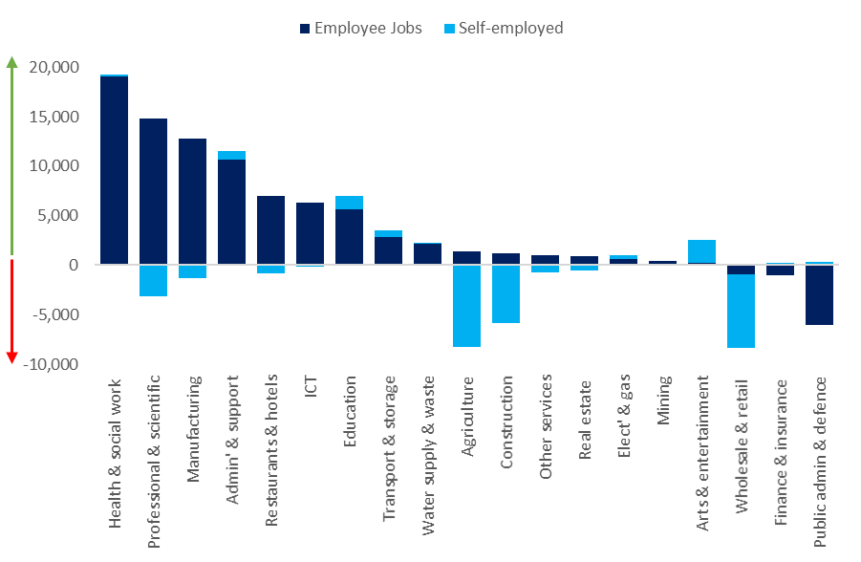
Where have jobs been created in NI?
Self-employment largely impacted by COVID
Employee and self-employment change by industry, NI, 2011 – 2021
Net change: 57k
Employee jobs: +79k
Self-employed: -22k
Source: Workforce Jobs & UUEPC Analysis

Slide 10
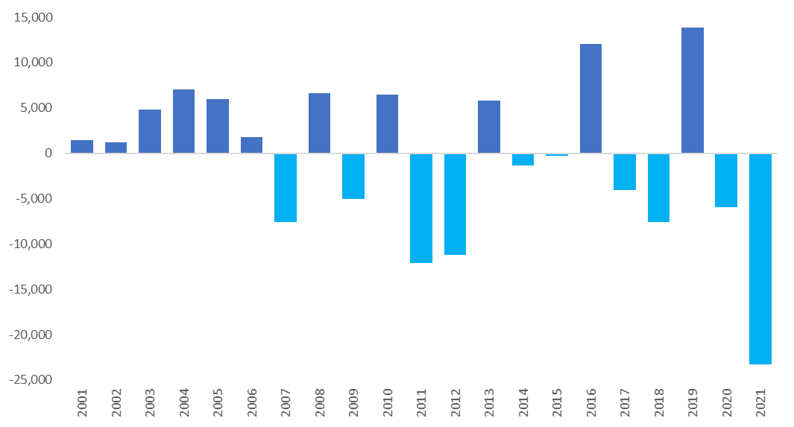
Annual changes in self-employment
Significant COVID impact on self-employment
Annual change in total self-employment, NI, 2001-2021
2000-08: +21k SE jobs created
2013-19: +13k SE jobs created
2009-12: -17k SE jobs lost
2020-21: -23k SE jobs lost
2001 SE as % NI total employment: 15%
2021 SE as % of NI total employment: 11%
Source: Workforce Jobs & UUEPC Analysis

Slide 11
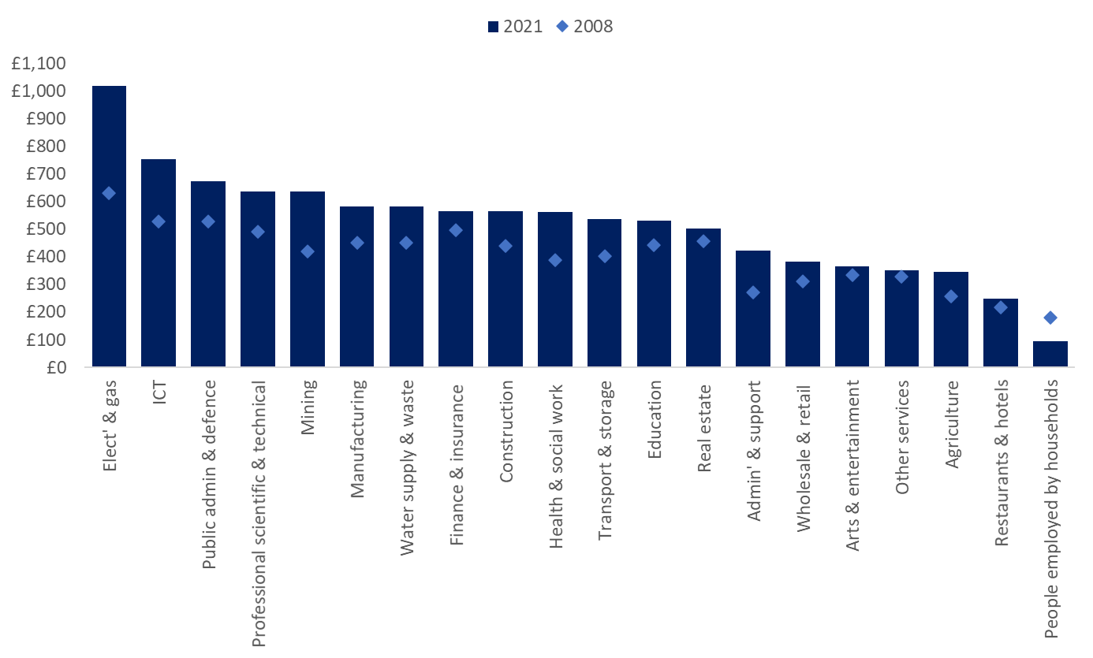
Wage increases since 2008, but cost of living has also climbed
Utilities experiencing the largest increase
Average weekly wages, NI, £, Current prices, 2008-2021
Source: UUEPC & ASHE

Slide 12
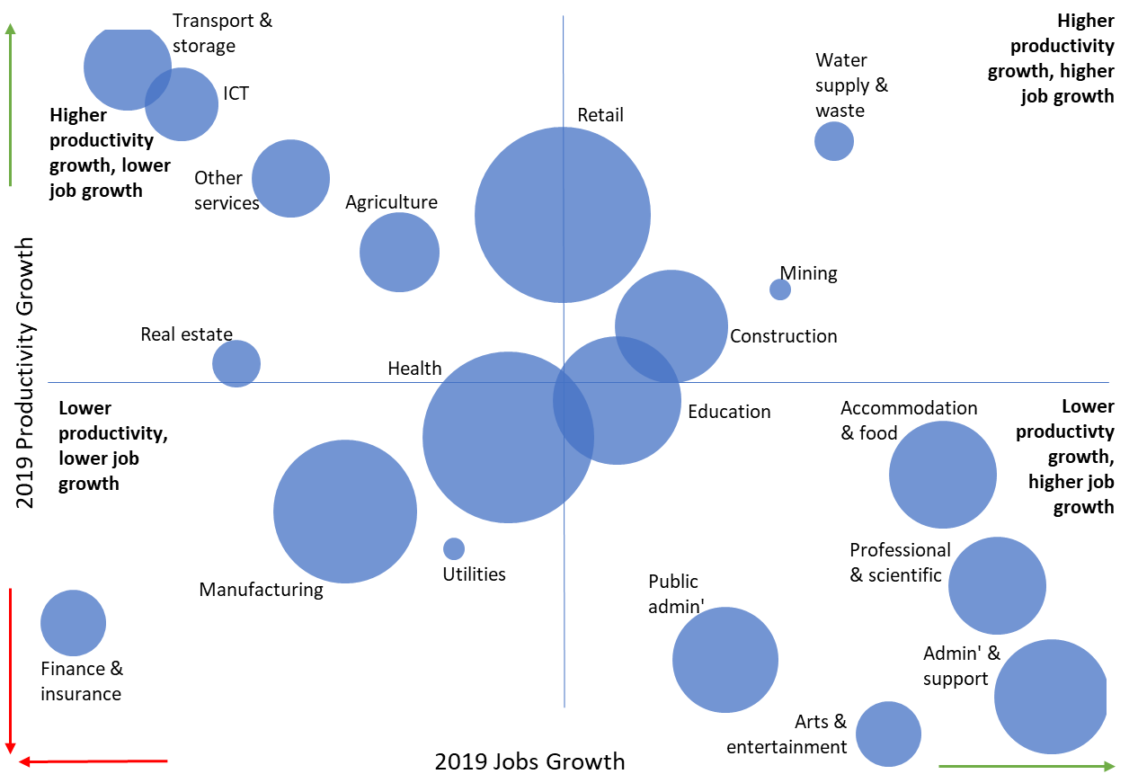
Sectoral productivity
Productivity and job growth, NI, 2019
Source: ONS & UUEPC Analysis
Note: People employed by households excluded

Slide 13
Northern Ireland
Economic Outlook

Slide 14
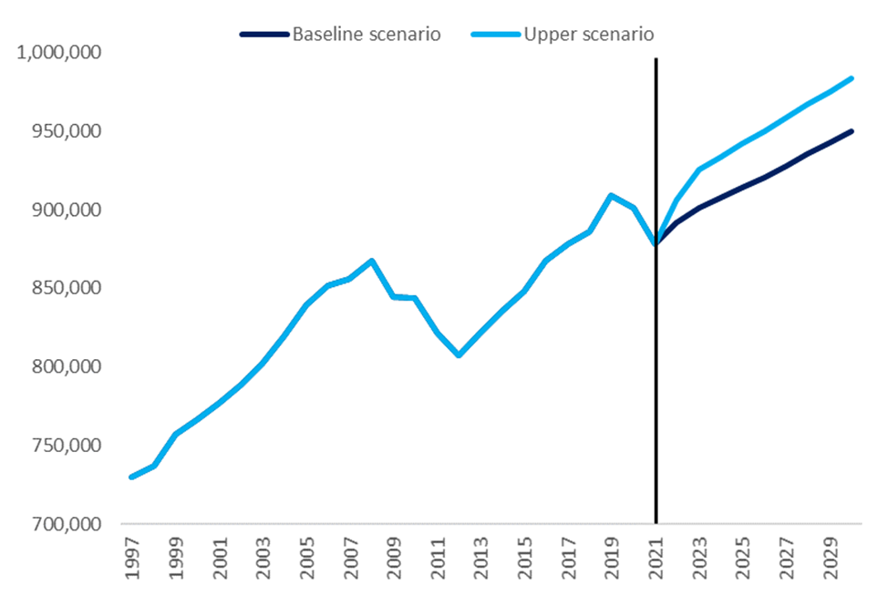
NI: Total Employment
NI labour market emerging from lockdown
Total employment, NI, 1997-2030
Total employment dropped from 901,000 in 2020 to 878,000 in 2021.
NI is forecast to gain nearly 14,000 jobs in 2022 with total employment anticipated to rise to 892,000.
In 2025, NI is expected to surpasses pre-pandemic employment, reaching 914,000 jobs in the central scenario.
By 2030 the baseline scenario forecasts that there will be 950,000 jobs in NI, increasing by 58,000 from 2022.
The upper scenario suggests total employment could reach 983,000, an increase of 77,000 jobs from 2022.
Source: ONS (Workforce Jobs) & UUEPC Local Model Forecast Spring 2022

Slide 15
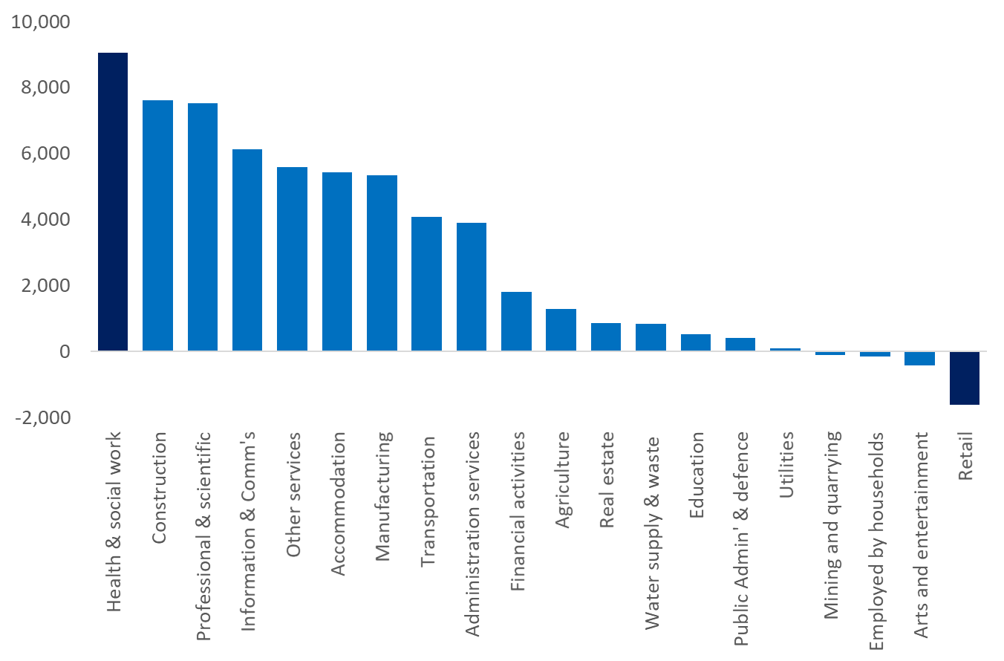
NI: The Sectoral Job Growth
Has the shift to digital led to the decline of retail?
Net employment change by sector, central scenario, NI, 2022-2030
Under the central scenario nearly 58,000 jobs could be added to the NI economy from 2022.
Health and social work are anticipated to make up the majority of these jobs, gaining 16% equating 9,000 jobs.
Construction and professional services are each anticipated to gain 13% of jobs, gaining 7,600 and 7,500 jobs respectively.
Retail is forecasted to decline by -1,600 jobs by 2030, or 200 jobs per year over the next eight years.
Source: NISRA (BRES) & UUEPC Model Forecast Spring 2022

Slide 16
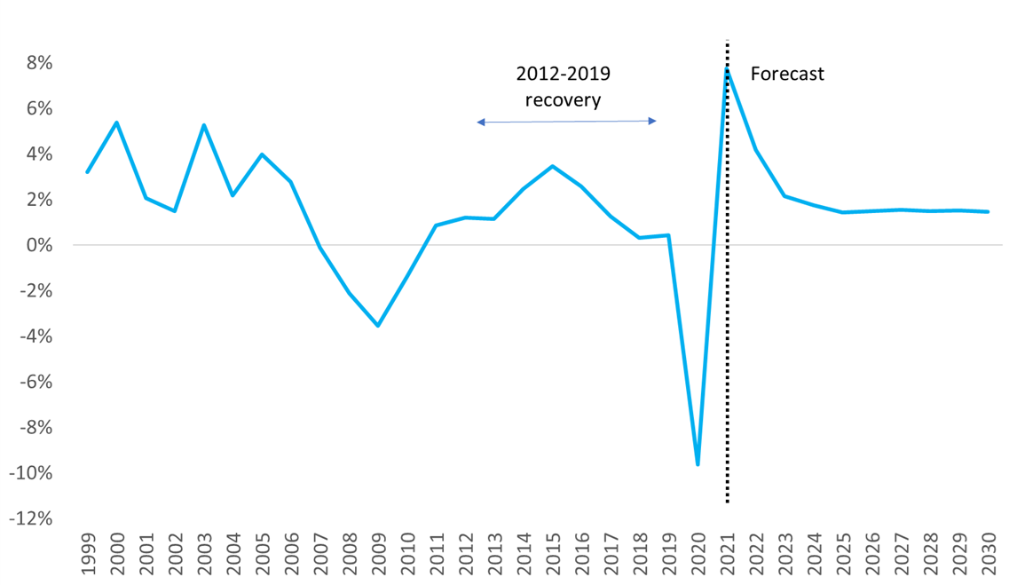
NI: Real GVA Growth Rates (%)
Decline in 2020, followed by recovery and ‘normality’ by 2024
Real GVA annual growth rates (%), NI, 1999-2030
NI’s real GVA grew by 7.7% in 2021- however from a smaller base in 2020.
Real GVA grew to £40.2bn in 2021 from £37.3bn in 2020.
In 2022, real GVA is forecasted to grow by 4.2% in the baseline scenario as we emerge from COVID- however the war in Ukraine provides an uncertain backdrop to growth.
It is forecasted that real GVA in 2023 will surpass 2019 levels.
Source: ONS (Regional Accounts), NISRA & UUEPC Outlook Spring 2022

Slide 17
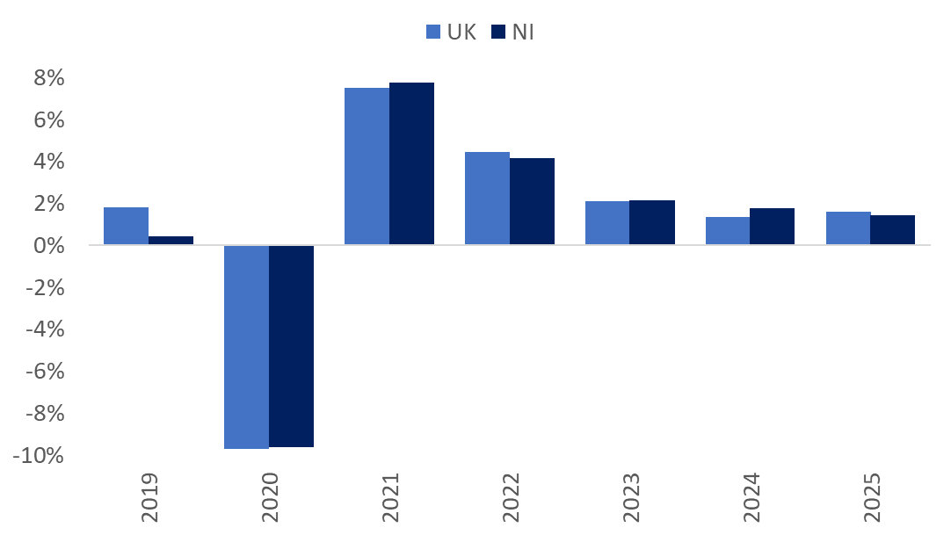
Real GVA Outlook – NI and UK
Recovery followed by ‘normality’ in GVA in growth rates
Real GVA growth rate, UK vs NI, 2019-2025
Source: CBR and UUEPC Outlook Spring 2022

Slide 18
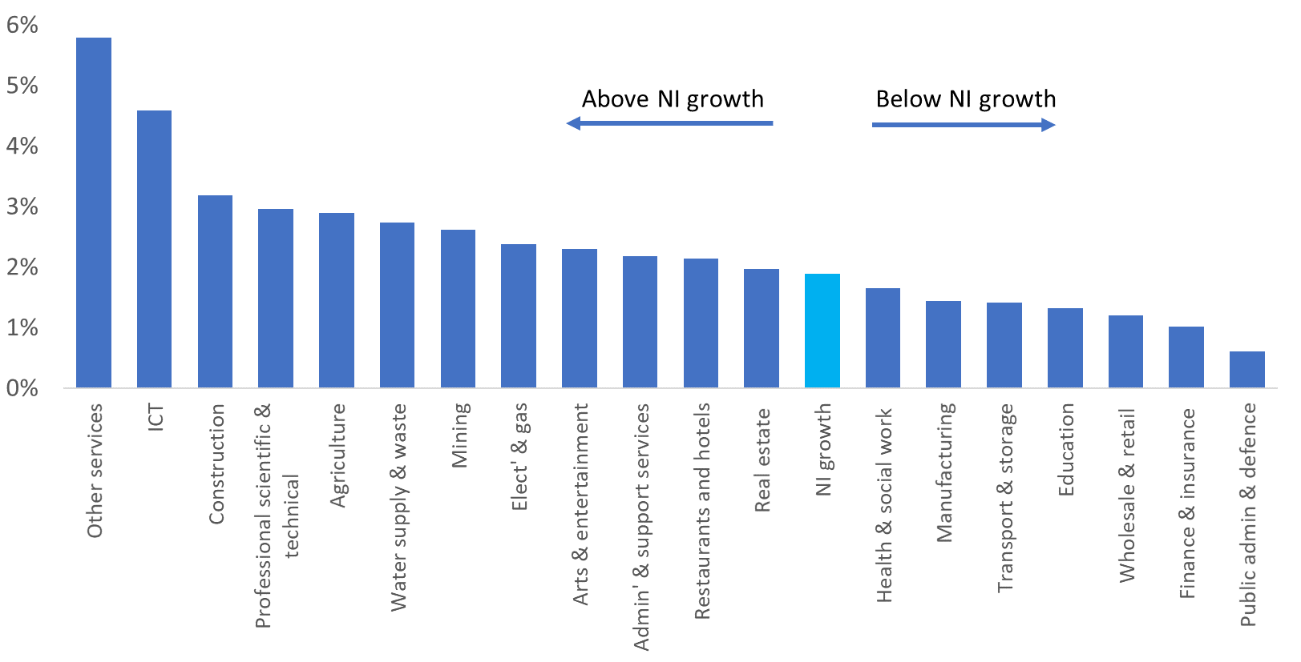
Real GVA growth by sectors
Other services experiencing the largest annual real GVA growth
Real GVA compound annual growth rates by sector, NI, 2021-2030
Source: ONS & UUEPC Outlook Spring 2022

Slide 19
Causeway Coast and Glens
New data insights for local economies

Slide 20
Newly available real time data
The availability of timely data at a local government level has historically been limited.
Recent developments of economic indicators at local government level allows for a more detailed picture of local labour markets and socioeconomic conditions. The availability of timely data allows us to offer more specific and up to date analysis where many publications rely on data which is often published at annual intervals or relies on census data with decade long intervals.
These updates also give us indicative interim data whilst waiting for larger annual releases such as the Labour Force Survey (which is normally released a year later).
Although timely data is important, we believe Councils would gain benefits from the continuous development of wider economic and societal indicators at smaller geographical areas, even when these have to be released on a lagged basis – the development of the exports data for local Councils is a good example.

Slide 21
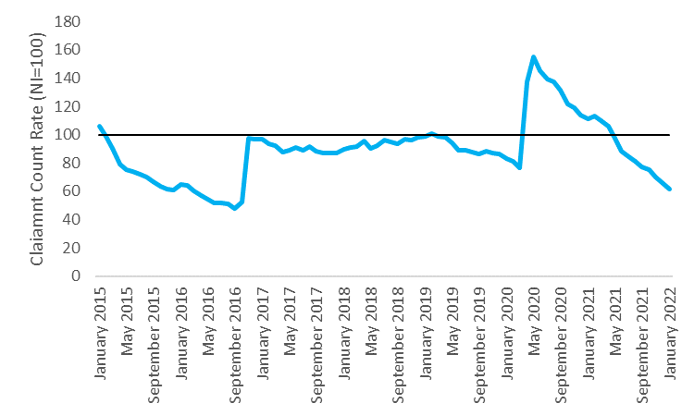
Claimant Count
Pandemic count surge beginning to return to pre-pandemic levels
Indexed Claimant Count Rate (NI=100), Causeway Coast & Glens, Jan 2015 – Jan 2022
The number of people registered on claimant count in Causeway Coast & Glens is generally on par with NI average (indexed at 100 on the graph). However, the spike in mid 2020 would suggest that residents in Causeway Coast & Glens were disproportionately affected by the pandemic compared to those elsewhere in Northern Ireland.
The numbers of claimant count have however fallen below their pre-pandemic council level average indicating a healthy recovery with limited long-standing effects.
Source: NISRA

Slide 22
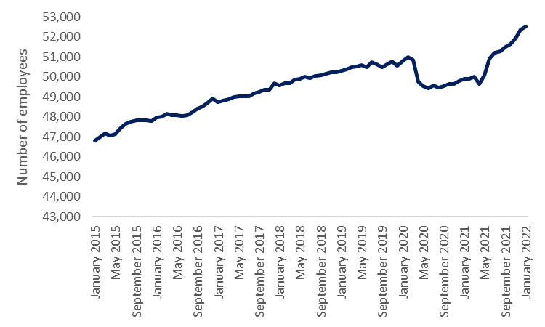
Payrolled Employees
Employment starting to return to pre-pandemic trend
Payrolled employees, Causeway Coast & Glens, Jan 2015 – Jan 2022
The number of payrolled employees has risen steadily from 2015 - early 2020. A dip in employment figures during the pandemic was experienced not only across the rest of NI but across the wider UK as well.
The implementation of such extensive employment support schemes has shielded large scale redundancies and unemployment however it has not been without some effects as outlined by the graph.
Source: HMRC
Note : PAYE data is a partial measure of employment and does not include the self-employed. It should also be noted that due to payroll reforms more people will be accounted for within the measure from Spring 2021.

Slide 23
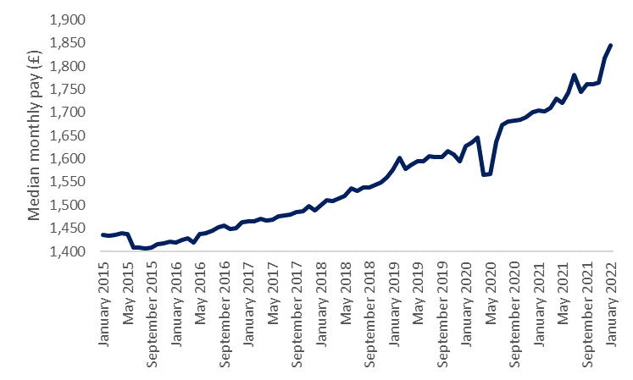
Median Wages
Median wages (£), Causeway Coast & Glens, Jan 2015 – Jan 2022
Median wages have risen consistently since 2015, experiencing a small pandemic related dip mid-2020.
More recently wages have increased at a faster rate reflecting a tight labour market where workers have more bargaining power and wages that may have risen in line with inflation
Median wages in Causeway Coast & Glens rank 9th in comparison to other council areas
Source: HMRC
Note: PAYE data is a partial measure of employment and does not include the self-employed. It should also be noted that due to payroll reforms more people will be accounted for within the measure from Spring 2021.

Slide 24
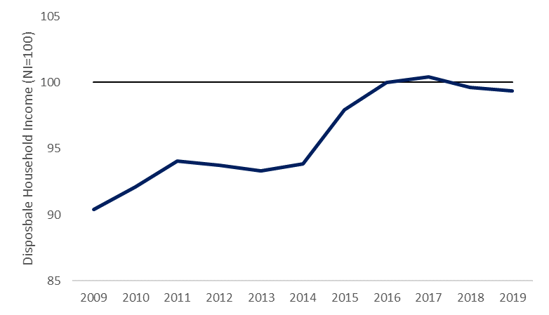
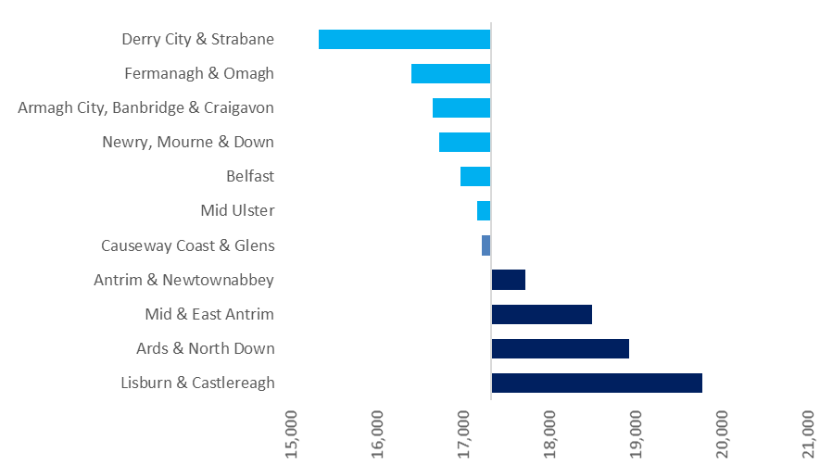
Disposable Household income
Increasing disposable household income but in line with NI growth
Disposable household income (NI=100), Causeway Coast & Glens, 2009 – 2019
Disposable household income per capita , NI LGDs, 2019
In nominal terms disposable income has risen steadily within the council area over the last 10 years indicating an increase in standard of living. When benchmarked against NI disposable income it has fallen slightly below the NI average in recent years despite closing a sizeable gap from 2009. In 2019 disposable income per capita in Causeway Coast and Glens ranked fifth out of all council areas in NI.
Source: ONS

Slide 25
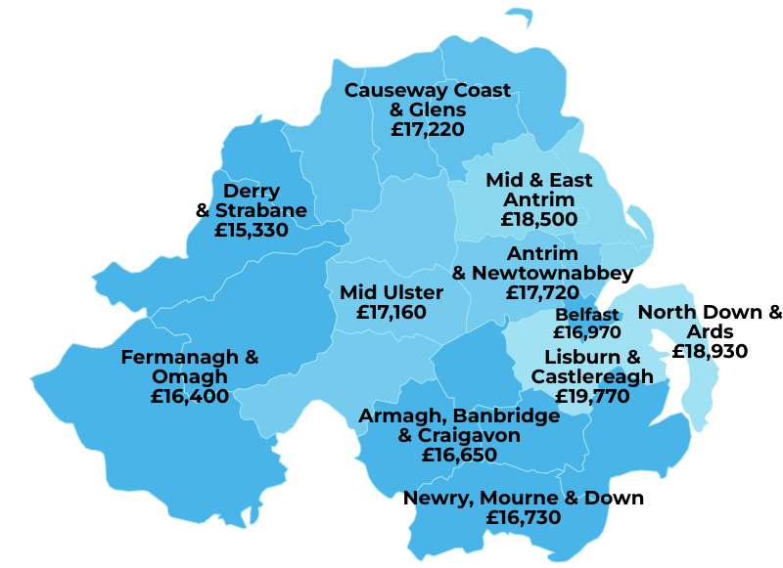
Disposable income across councils

Slide 26
Causeway Coast and Glens
Recent Performance and Economic Outlook

Slide 27
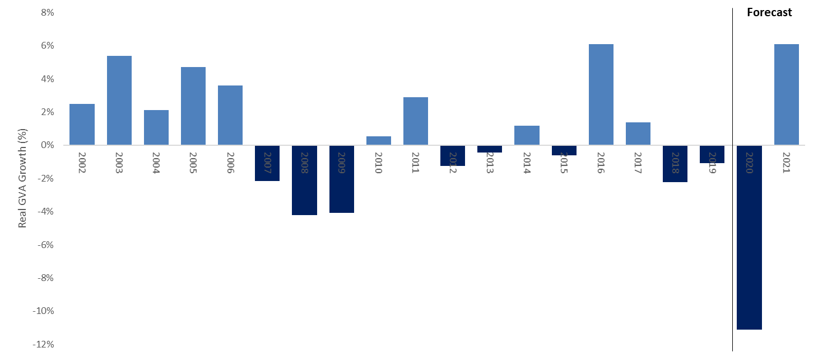
Baseline forecasts show the COVID effect
Real GVA Growth Rate (%) to be equal to the NI rates
Real GVA growth rate (%), Causeway Coast & Glens, 2002-21
Causeway Coast and Glens real GVA growth rate for 2019 was -1.1%, the estimated figures for 2020 and 2021 are -11.1% and 6.1% respectively.
Forecasted average annual growth rate of 1.6% (2022-30) – equal to the NI average of 1.6% per annum for the same period
Source: ONS (Regional Accounts), NISRA & UUEPC Local Model Forecast Spring 2022

Slide 28
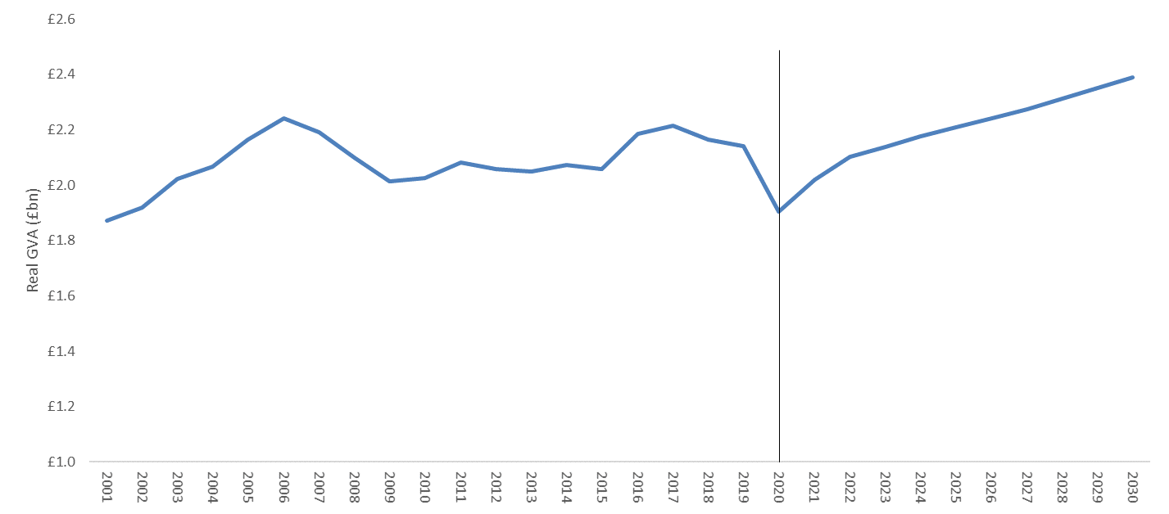
Steady recovery in GVA forecast out to 2030
Real GVA (£bn) to reach 2019 peak by 2022
Real GVA (£bn), Causeway Coast & Glens, 2001-30
Under the baseline scenario real GVA is within the council area is forecasted to increase by 13.6% over the 2022-30 period from £2.1bn (2022) to £2.4bn (2030).
GVA in 2020 and 2021 as estimated at £1.9 and £2.0bn respectively.
Source: ONS (Regional Accounts), NISRA & UUEPC Local Model Forecast Spring 2022

Slide 29
GVA growth limited in most sectors
Real GVA CAGR (%) forecasts highlight increase in financial activities and other services
Real GVA CAGR (%), Causeway Coast & Glens 2022-30
Real GVA growth is forecast to be 1.6% per annum between 2022-30. Other Services and Construction are forecast to drive growth as well as Professional & Scientific.
Mining & quarrying alongside Arts & entertainment are expected to decline in the medium term.
Source: ONS (Regional Accounts), NISRA & UUEPC Local Model Forecast Spring 2022

Slide 30
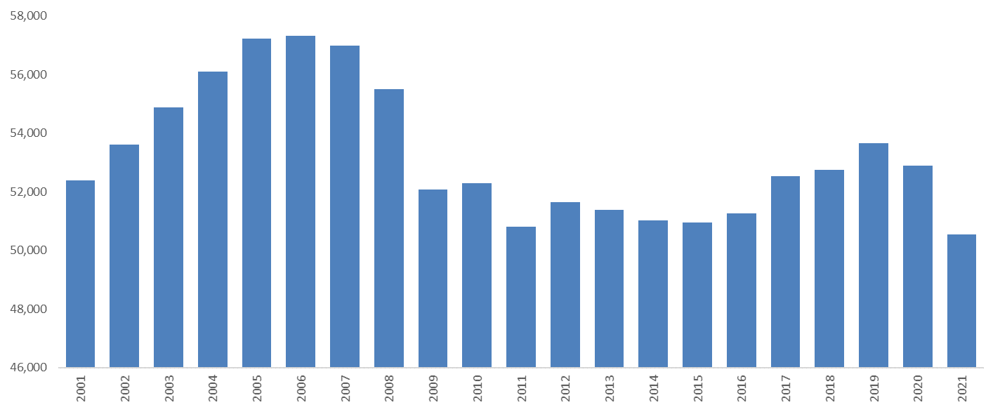
Strong Employment growth
Slight dip in employment in 2020 but employee jobs protected by furlough
Total workplace employment, Causeway Coast & Glens, 2001-21
Total employment in Causeway Coast and Glens has decreased from 52,400 in 2001 to 50,500 in 2021 – 3.8% decrease. However, 2015-2019 saw strong pre-pandemic employment growth.
The council area accounted for 5.8% of total jobs in NI for 2021
Historically Retail has been a key sector for employment opportunities accounting for 16.6% of the workforce.
Self employment was adversely affected during the Covid-19 pandemic. Within the council self-employment has fallen from 20% of total employment to 16% over the 2019-2021 period which translated to a loss of approximately 2,600 self-employed jobs.
Source: NISRA (BRES) & UUEPC Analysis

Slide 31
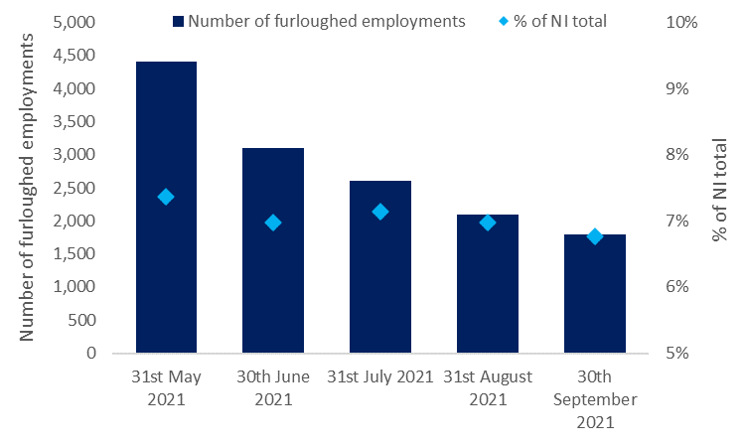
Effects of the furlough scheme
Number of furloughed employments and % of NI total furloughed employments, Causeway Coast & Glens, May – September 2021
The number of furloughed employments in Causeway Coast & Glens decreased in the final months of the Coronavirus Job Retention scheme (CJRS) in line with the overall NI trend.
Causeway represented approximately 7% of total furloughed employments in Northern Ireland. This figure remained consistent across the duration of the scheme.
On the final day of the CJRS scheme 1,800 employments within the council area were registered on furlough.
Source: HMRC

Slide 32
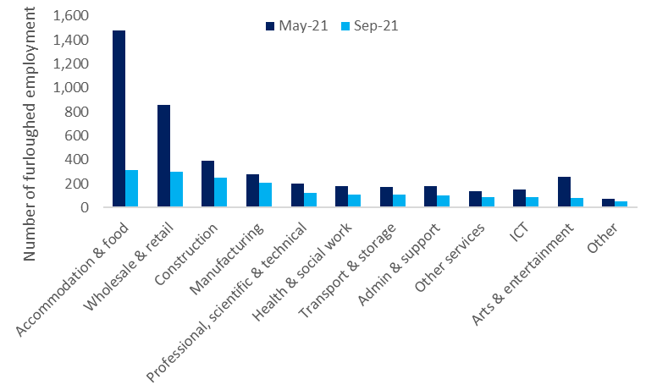
Furlough support by sector
Number of furloughed employments by sector, Causeway Coast & Glens, May vs. September 2021
The sectors most heavily reliant on the furlough scheme in May 21 remained the same as those in September 21 however at a much lower rate.
ICT however had a higher rate in May 21 but had “bounced back” to a lower rate by September, largely owing to the easing of Covid-19 restrictions and the gradual return to the office.
The biggest difference came in Accommodation & Food indicating a healthy recovery within the hospitality sector.
Source: HMRC

Slide 33
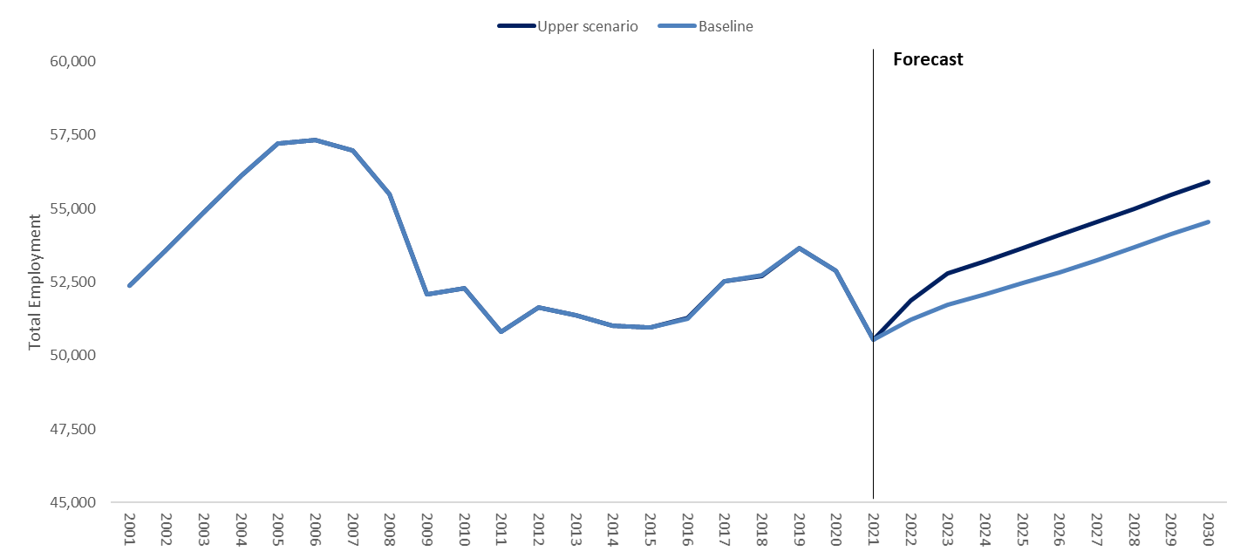
Causeway Coast & Glens:
Total Workplace Employment
Total workplace based employment, Causeway Coast & Glens, 2001-30
Total employment under the baseline scenario is forecasted to increase to 54,500 by 2030, up from 51,200 in 2022 – a 6.8% increase
Upper scenario forecasts total employment to be 55,900 by 2030
Source: NISRA (BRES) & UUEPC Local Model Forecast Spring 2022

Slide 34
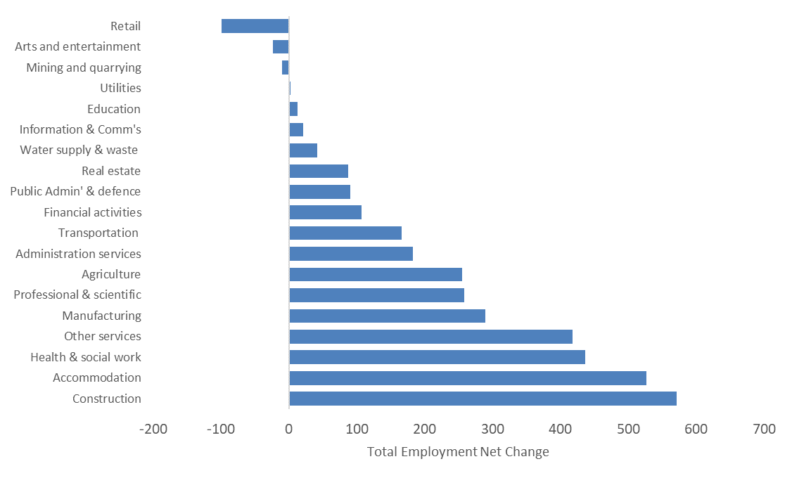
Causeway Coast & Glens:
Sectoral Employment Change
Change in employment, Causeway Coast & Glens, 2022-2030
Causeway Coast & Glens is forecasted to gain around an additional 3,300 jobs by 2030
The main driver of this increase is growth within the construction and hospitality sectors.
Retail on the other hand is set to lose approximately 100 jobs with other minor decreases in arts & entertainment and mining.
Source: NISRA (BRES) & UUEPC Local Model Forecast Spring 2022

Slide 35
Causeway Coast & Glens:
Changing sectoral trends
Total workplace based employment (Net Change), Causeway Coast & Glens, 2012-30
Manufacturing and Other services have been the main drivers over 2012-19 period with 2,100 jobs created – this strong job growth has been offset by job losses in other sectors over the same period.
Construction and Hospitality are set to drive jobs over the next decade with 1,100 jobs being created alone between these two key sectors.
Sectoral revisions have been made and the retail sector is still expected to decline but to a lesser extent that previously thought by 2030. Retail also suffered considerably as a result of Covid-19.
Growth within the public sector is predominately within the health and social work.
Source: NISRA (BRES) & UUEPC Analysis

Slide 36
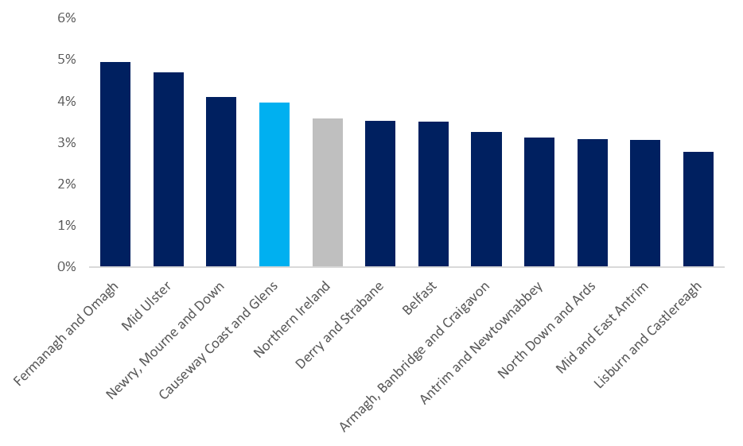
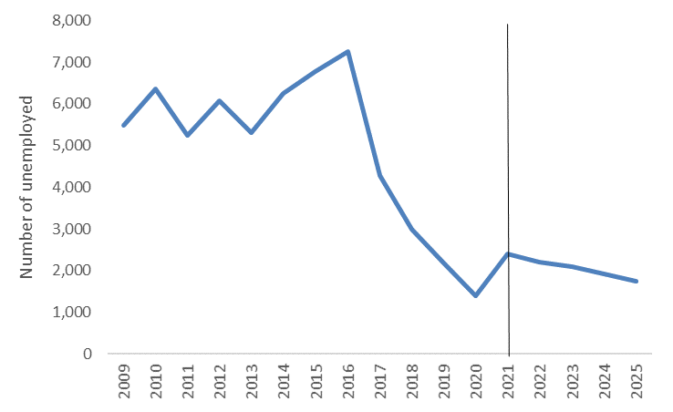
Causeway Coast & Glens:
Unemployment Rate
Resident unemployment rate (%), Causeway Coast & Glens, 2009 - 2025
Resident unemployment rate (%), NI LGD’s, 2021
forecast
The resident unemployment rate for 2021 in Causeway Coast & Glens is 4.0% which translates to approximately 2,400 unemployed individuals.
Unemployment within the council area has declined at a rapid rate between 2016-2020 before a slight upswing in 2021 owing to the pandemic. Over the next number of years the unemployment rate is expected to decline further to 1,750 individuals by 2025.
Source: UUEPC Local Model Forecast Spring 2022

Slide 37
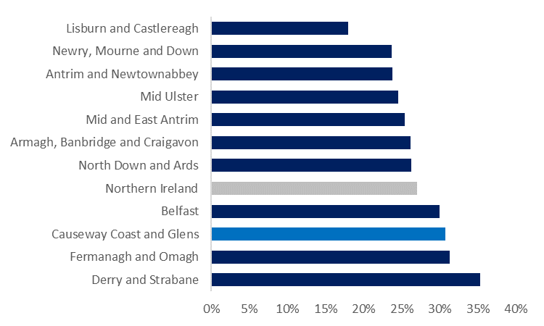
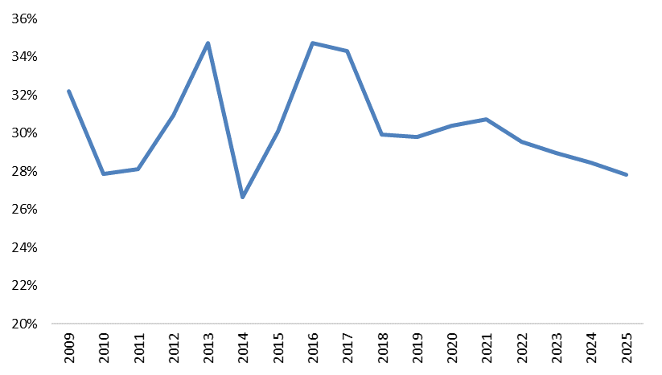
Causeway Coast & Glens:
Economic inactivity
Economic inactivity rate (%), NI LGD’s, 2021
Economic inactivity rate (%), Causeway Coast & Glens, 2009-2025
forecast
Despite the economic inactivity rate regularly fluctuating within Causeway Coast & Glens, over the last number of years this rate has been steadily increasing within the council area. In 2021 the rate in Causeway Coast & Glens (30.7%) sits above the NI average (27.1%)
Economic inactivity is forecasted to continue to gradually fall to 27.8% by 2025 in
Causeway Coast & Glens.
Source: UUEPC Local Model Forecast Spring 2022

Slide 38
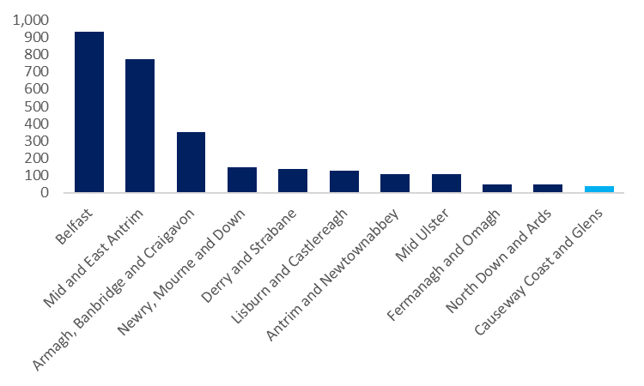
Causeway Coast & Glens:
Redundancies
Confirmed redundancies, NI LGD’s, 2021
Causeway Coast & Glens has a lower number of redundancies relative to the rest of NI. The council area also offers a lower proportion of redundancies (1%) compared to the employment opportunities that the council offers (6% of NI total).
Source: NISRA

Slide 39
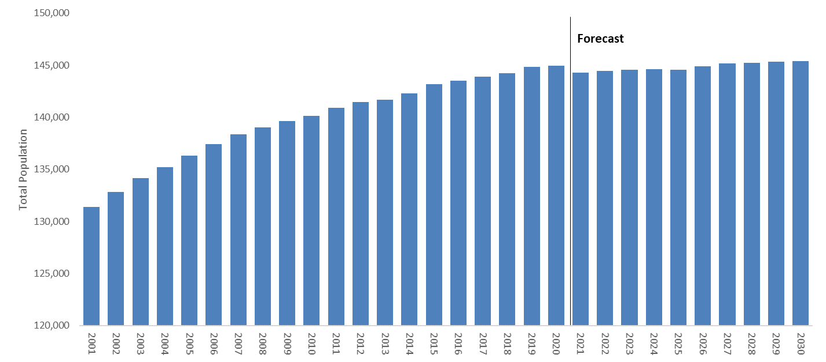
Causeway Coast & Glens
Total Resident Population
Total resident population, Causeway Coast & Glens, 2001-30
Total population is forecast to increase very slightly from 144,300 (2021) to 145,300 (2030)
The increase at the older end of the population pyramid is likely to have impact on a variety of policies such as;
    Housing demand
    Demand for services (especially health)
    Rates
The UUEPC assume that the additional jobs to e created in the Borough will be filled by a mixture of residents entering the workforce and in-commuters, but that a tight labour market can continue to be expected.
Source: NISRA & UUEPC Local Model Forecast Spring 2022

Slide 40
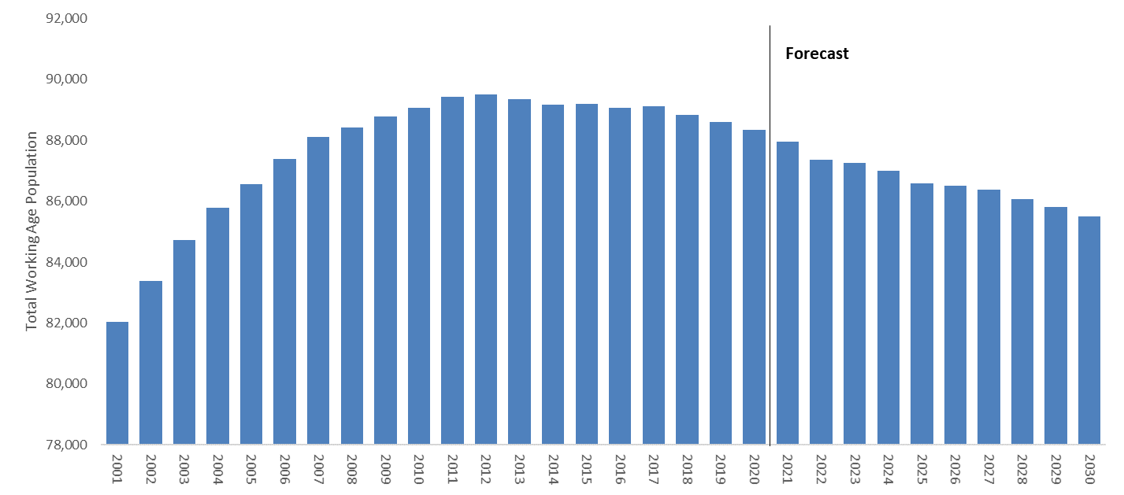
Causeway Coast & Glens:
Resident Working Age Population
Resident working age population, Causeway Coast & Glens, 2001-30
Working age population is forecast to decrease from 87,900 (2021) to 85,500 (2030)
Note the decline in the working age population has already begun in recent years and appears to be further exacerbated over the next decade. With an already tight labour market the reduction in growth of the working age population may pose a significant challenge over the next decade – inactivity and tackling under-employment may be key.
Source: NISRA & UUEPC Local Model Forecast Spring 2022

Slide 41
Concluding Points

Slide 42
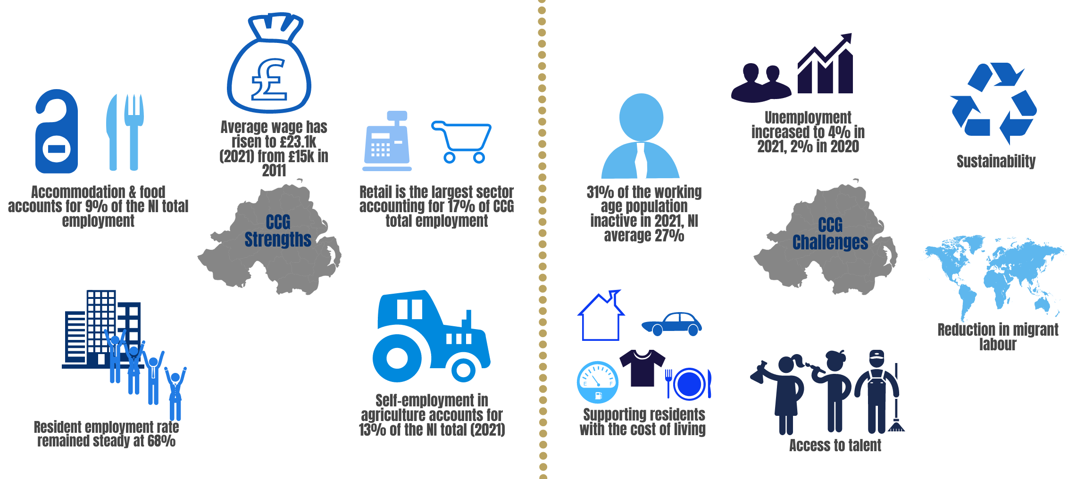
Strengths & Challenges: Causeway Coast & Glens
Source: UUEPC Local Model Forecast Spring 2022

Slide 43
Key considerations for Causeway Coast & Glens
How best to provide a lead in a time of ‘known unknowns’ – cost of living pressures, the NI Protocol, etc – without becoming distracted from longer-term strategies for the Borough and its local economies
Continued awareness of risks attached with COVID, in particular scarring effects on employment, especially in an already tight labour market
Innovation, innovation, innovation … this will be the key word in policies (10X strategy and Climate Action plans) and how the local growth deal is structured – question of how inclusive this can be.
What are the priorities for the new Labour Market Partnerships in a period of structural change with declining working age population?

Slide 44
Appendix and Glossary

Slide 45
Use of Forecasts
Forecasts are useful to help councils guide any future potential policy direction / decisions, in areas such as;
    Planning;
    Economic development; and
    Public facilities management.
But, forecasts are conditional on a range of underlying factors, in particular;
    Historical / Past trends;
    The policy environment; and
    The current economic environment (Locally, Nationally & Globally).
These underlying factors are major determinants of future performance as they reflect the relative competitiveness of an area / sector in the present and into the future
The UUEPC’s local forecasts presented in this slide deck are calculated using a top-down approach – i.e. UK forecasts allocated to the UK Regions (i.e. NI) & these NI forecasts are then allocated to each of the 11 council areas
The forecasts presented do not consider local initiatives or strategies that have yet to be approved (i.e. current policy framework remains unchanged)
45

Slide 46
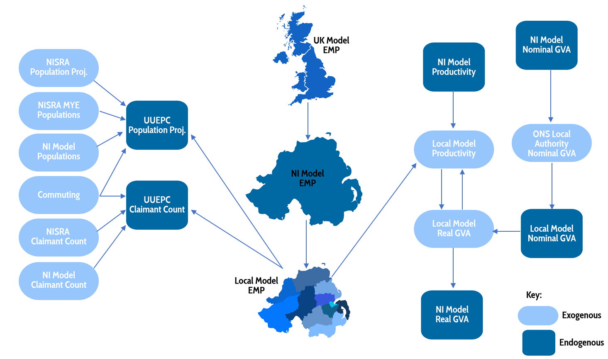
Forecasts and their construction
UUEPC Suite of Economic Forecast Models
Source: UUEPC Local Model Forecast Spring 2022

Slide 47
Glossary of Key Terms
Workplace based Employment
  The number of people employed by location of work
Resident based Employment
  The number of people employed by location of residency
Real GVA
  The measure of the value of goods and services produced in an area, industry or sector of an economy. Real value is the nominal value adjusted for inflation and is obtained by removing the effect if price level changes from the nominal value of time-series data
Productivity
  Measures how efficiently production inputs are being used in an economy to produce a given level of output. Productivity within the UUEPC Model is derived from total GVA divided by the number of people employed
Economic Inactivity Rate (%)
  The rate of those within the working age population who are not in employment, nor actively seeking employment from one year to the next.

Slide 48
Glossary of Key Terms
CAGR (%)
  The compound annual growth rate (CAGR) is the mean annual growth rate of an over a specified period of time longer than one year.
Labour Force
  Those people who are at the working age (16-64), and are able and willing to work.
Working Age Population
  Those aged between 16 and 64
ILO Unemployment Rate (%)
  The rate of those who are: out of work, want a job, have actively sought work in the previous four weeks and are available to start work within the next fortnight changes from one year to the next

Slide 49
Thank You

Slide 50


Contact Details
Gillian McCausland
Economist: Ulster University Economic Policy Centre
Email: g.mccausland@ulster.ac.uk
Telephone: 02890 366 219
Ana Desmond
Economist: Ulster University Economic Policy Centre
Email: a.desmond@ulster.ac.uk
Dr. Eoin Magennis
Senior Economist: Ulster University Economic Policy Centre
Email: e.magennis@ulster.ac.uk
Telephone: 02890 366 219
Ruth Donaldson
Student Economist: Ulster University Economic Policy Centre
Email: r.donaldson@ulster.ac.uk
Ulster.ac.uk/epc
Ulster Uni EPC
Ulster University Economic Policy Centre

