Slide 1
Causeway Coast & Glens Capital Grants Workshop
Closing Date: 26 May 2017
www.causewaycoastandglens.gov.uk

Slide 2
 | Agenda Item | Presenter
1. | Welcome & Introductions | Patricia O’Brein
2. | Programme Summary & Key Principles | Patricia O’Brien
3. | Ulster Community Investment Trust (UCIT) - Loan Opportunities for Community Opportunities | Trudi Dunbar
4. | Making an application: Criteria Developing your Business Case Avoiding the pitfalls | Nick Harkness
5. | Sports Facilities Strategy | Wendy McCullough
6. | Community Facilities Framework | Louise Scullion

Slide 3
Agreed Grant Programmes 2017-18
 | Grant Programme | % | Max grant available
1 | Building a United Community Fund | 100% | £1,500
2 | Community Development Support Grant | 75% | £1,000 / £2,000
3 | Community Festivals Fund | 75% | £500 / £1,500 / £5,000
4 | Culture, Arts and Heritage Grant Scheme | 75% | £1,000
5 | Individual Artists Bursary Scheme | 75% | £200
6 | Youth Creative Skills Bursary Scheme | 75% | £200
7 | Large Events Funding | 50% | £100,000
8 | Small Events Funding | 50% | £7,500
9 | Policing and Community Safety Grants | TBC | TBC
10 | Social Inclusion Grants | 85% | £500
11 | Sports Development Programme | TBC | TBC
12 | Capital Grants Programme | 50% | £200,000
13 | Landfill Communities Fund | 100% | £30,000

Slide 4
Grant Programmes 2016 -17
 | Grant Programme 2016/17 | No of successful Projects | Budget | Amount Requested | LoO Amount
1 | Building a United Community Fund | 8 | £14,600.00 | £12,512.30 | £10,928.55
2 | Community Development Support Grant | 52 | £93,016.00 | £91,398.55 | £91,016.00
3 | Community Festivals Fund | 57 | £70,049.00 | £91,833.00 | £70,049.00
4 | Culture Arts and Heritage Grant Scheme | 16 | £27,000.00 | £15,507.50 | £14,185.00
5 | Large Events Funding | 12 | £264,623.00 | £359,900.00 | £263,648.00
6 | Policing and Community Safety Grant Scheme | 12 | £65,000.00 | £103,313.20 | £62,323.40
7 | Queen's Birthday Fund Grant Scheme | 28 | £6,970.00 | £6,930.00 | £6,720.00
8 | Small Events Funding | 3 | £15,630.00 | £17,570.00 | £12,900.00
9 | Social Inclusion Grants | 34 | £18,889.00 | £21,787.33 | £16,464.00
10 | Capital Grants Programme | 1 | £750,000.00 | £180,000.00 | £180,000.00
11 | Christmas Festive Fund | 21 | £5,250.00 | £5,250.00 | £5,250.00
 | TOTALS | 244 | £1,331,027 | £906,001.88 | £733,483.95

Slide 5
Programme Summary:
Strategic Aim: To support external infrastructure projects that are aligned to Council’s aims and objectives.
Purpose: To support external infrastructure projects that require additional capital funding to achieve completion.
Funding Limits (currently under review):
Funding Pot: Circa £750k (subject to rate setting by Council)
Max Award Value: £200k
Max Council funding percentage: 50% (including other Council contribution e.g. RDS)
Capital only: buildings/infrastructure, 10+ years life, £15k min project cost
Eligible Applicants:
Not for profit Sports Clubs and Community Organisations
Good governance review: properly constituted, appropriate policies and procedures
No capital funding from Council in past 5 years
Support for Applicants:
Applicants can apply to Council for Mentor support

Slide 6
Key Principles:
A competitive fund: based on assessment criteria
Scoring favours high % of partnership/self funding: Council should be funder of last resort
Proven facility need is critical
Financial need must be demonstrated
Finite budget: High score doesn’t guarantee funding
Promotion of equality of opportunity and good relations
Outcome and not option led projects: aligned to Council’s priorities
Open procurement of both design and build teams: no self-build

Slide 7
Ulster Community Investment Trust (UCIT)
Trudi Dunbar

Slide 9
Ulster Community Investment Trust (UCIT) is a Charity providing loan finance to third sector organisations including charities, community organisations, social enterprises & sports clubs
Est’d in 2001 in response to concerns regarding decreasing grant support & the need for community organisations to have access to alternative sources of funding

Slide 10
Since Jan. 2001 – UCIT Loan Fund has assisted over 400 groups by providing loans in excess of £47m
Our clients include:
Sports Clubs
Community Development Associations
Churches/ Faith organisations
Childcare projects
Tourism Initiatives
Housing Associations
Enterprise & Workspace projects
Rural Development projects
Community Transport schemes

Slide 12
Benefits of UCIT loans
Minimum bureaucracy
Competitive Interest rate
Support & guidance throughout term of loan
No penalties against early repayment
Flexible & tailored specifically to need
As a charity all profits go back into the pot for reinvestment into the sector

Slide 13
Loans are available for:
Property – purchase, construction or renovation
Equipment
Renewable energy projects
Bridging funding gaps
Restructuring existing debt
Flexible working capital facilities
Shortfalls in funding packages

Slide 14
Loan Size typically £1,000 - £500,000 and over
UCIT Building Change Trust Loan Fund
(Unsecured loans of £1,000 - £25,000)

Slide 15
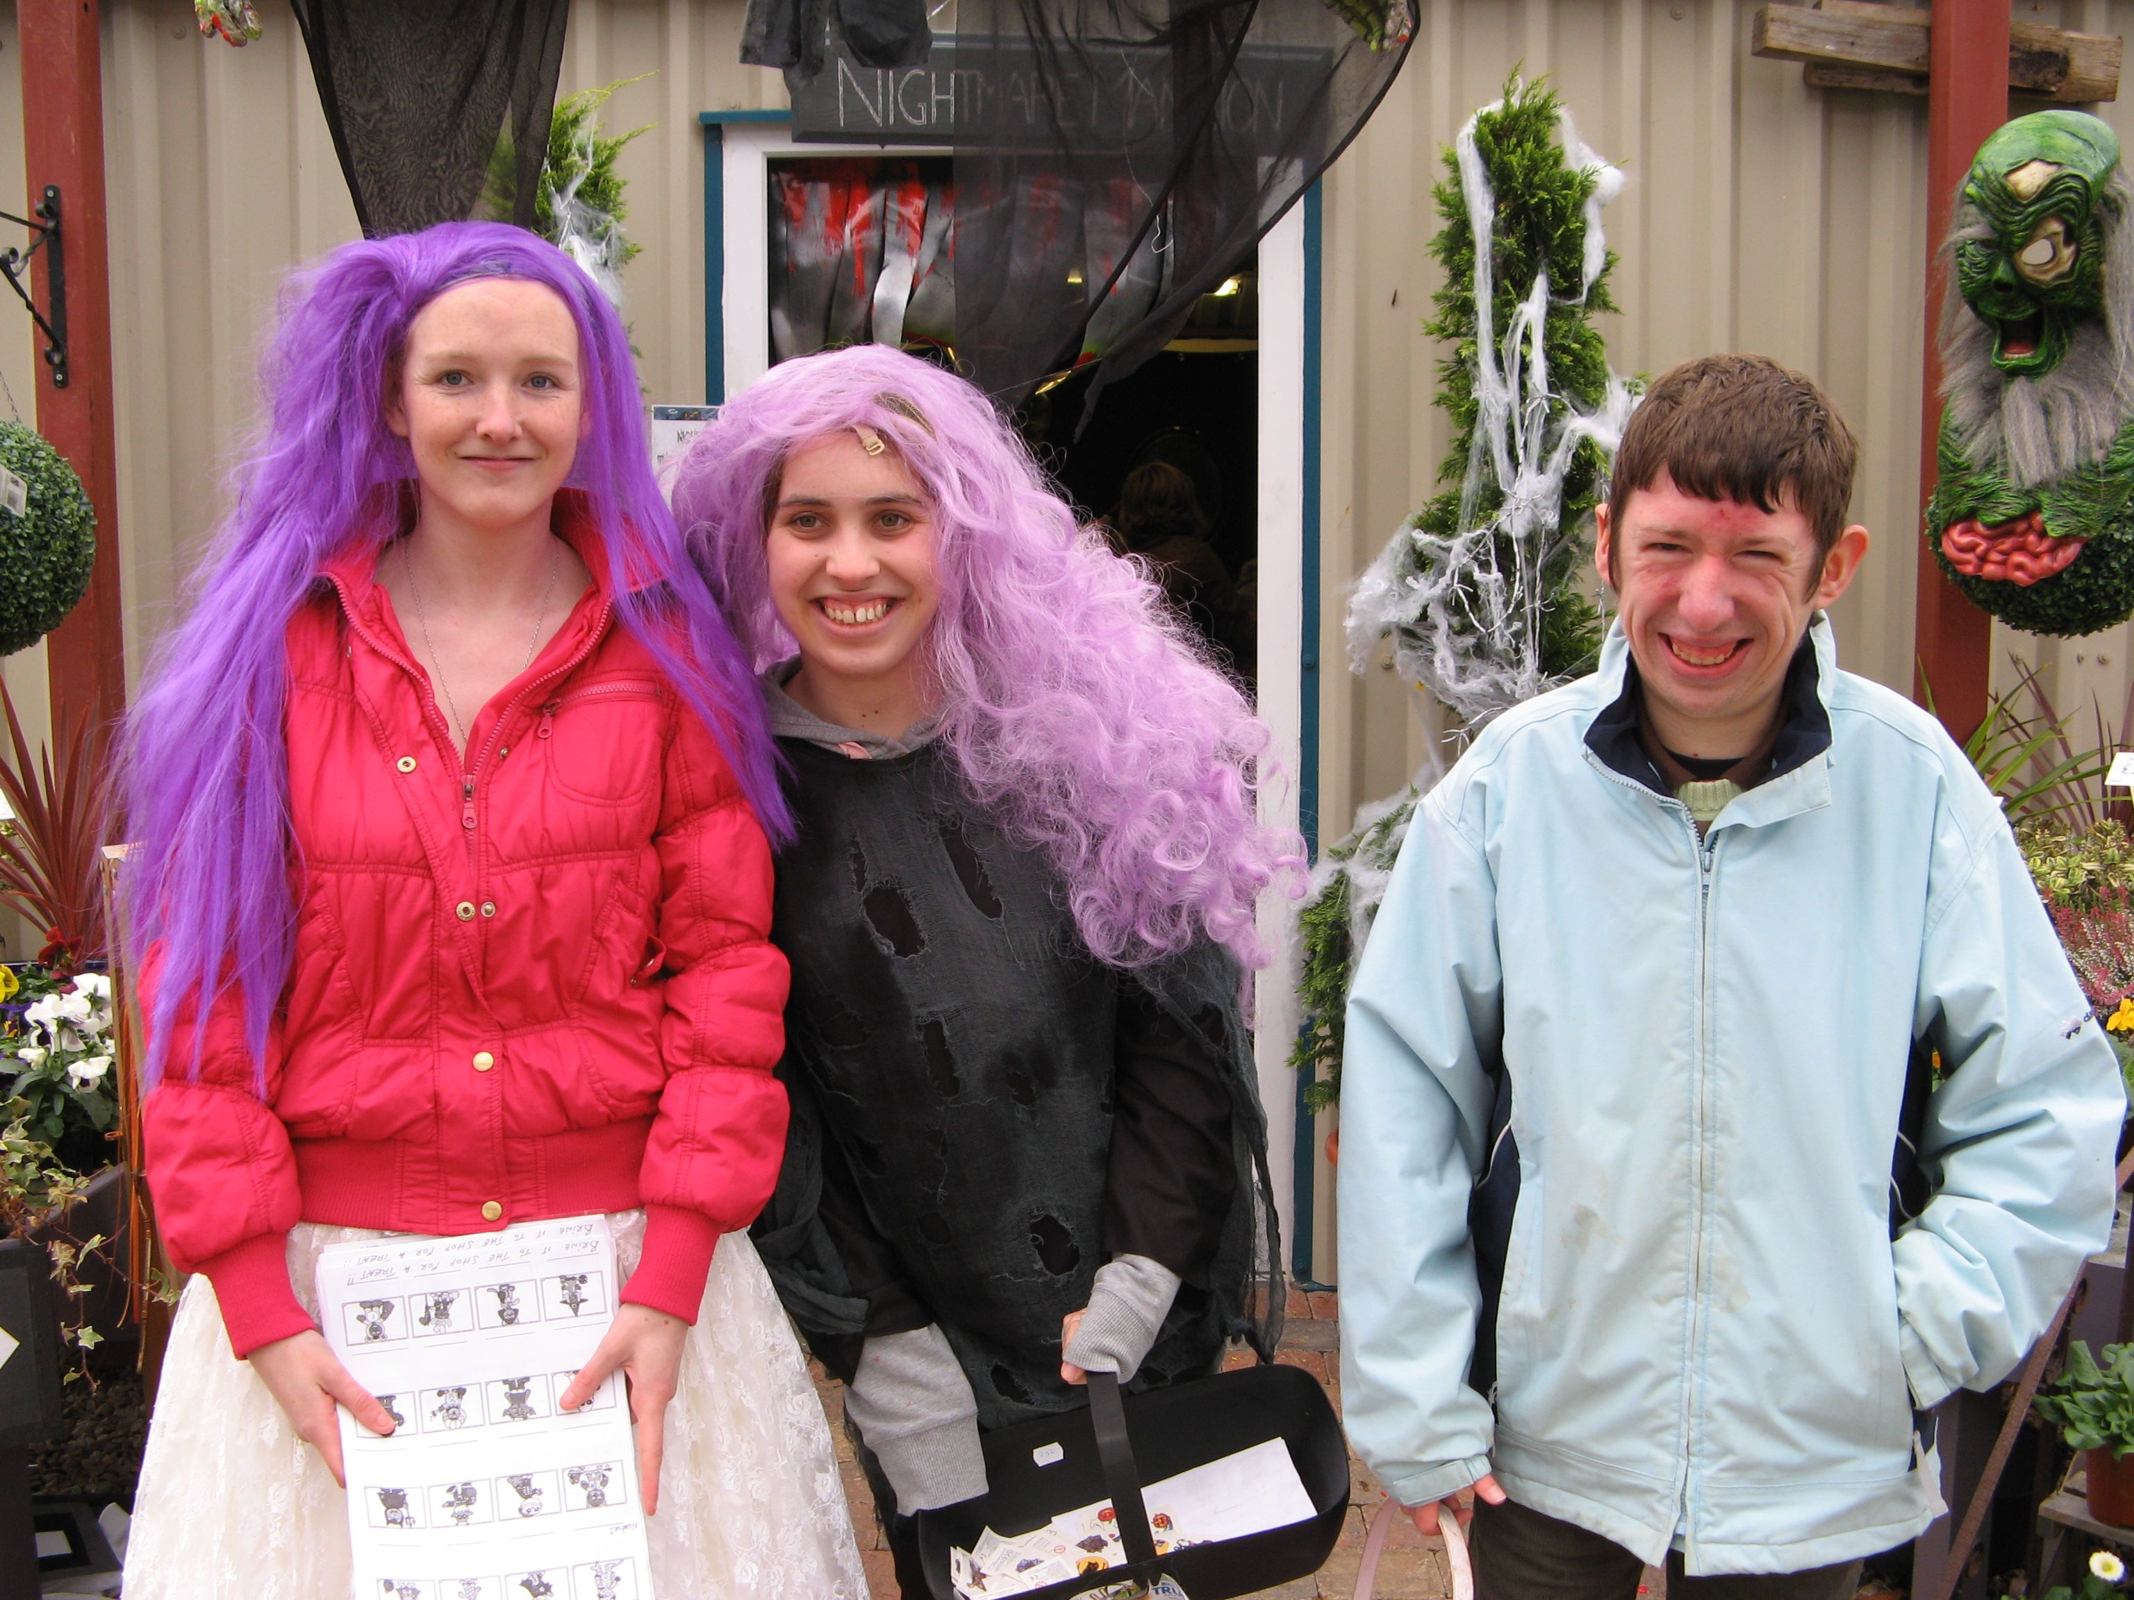
Greenlight Gateway, Ballycastle – UCIT provided a loan to enable the organisation to repay outstanding costs in relation to the expansion of their training café and garden shop.

Slide 16
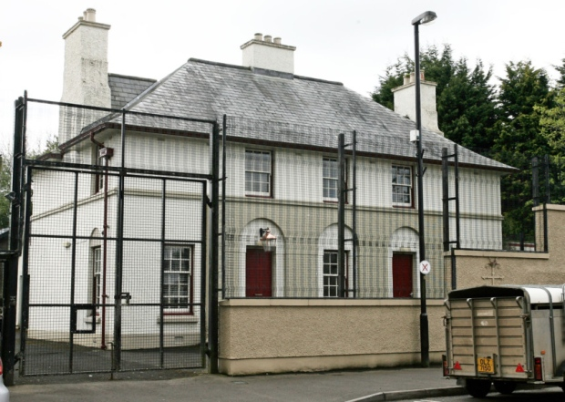
Broughshane & District Community Association – UCIT has provided the Assoc with a number of loans over the years to assist with the social & economic development of the village. The latest loan was used to purchase the former police station which will be transformed into a community hub & housing.

Slide 17
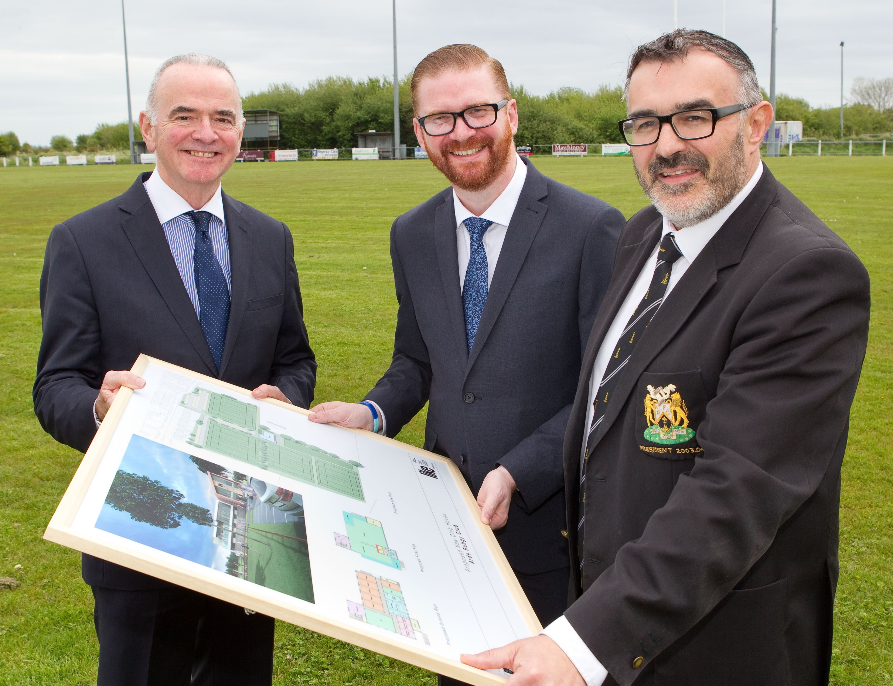
Ards RFC “Our only sources of income are through player subscriptions, fundraising and money from the bar. We received a recommendation from the Ulster branch of the IRFU that UCIT might be able to assist our future plans. The loan we received will help us to refinance the Club. In the next couple of years we are aiming to redevelop the club grounds, incorporating a new clubhouse facility, a 4G pitch and enhanced car parking and infrastructure.”
President, Neil Workman

Slide 18
John Mitchel's GAC Glenullin
UCIT provided a loan to the Club towards the funding package for the development of a 3G playing pitch. The organisation also accessed a bridging loan from UCIT to cover the VAT element of the build.

Slide 20
Making an Application:
Very light touch application form: organisation & project details
Accompanying business case required
Recommend professional support with business case re:
Early stage design options (no guarantee of ongoing commission)
Financial analysis of options CAPEX & OPEX and NPV calculations etc
Council Mentor support is available via separate application process
Closing date: 12 noon, 26 May 2017
After review of Phase 1: criteria & support materials have been updated
New material will be available online within the next few days

Slide 21
Eligibility/Shortlisting Criteria:
Properly constituted
Good governance: policies and procedures
Solvent and sustainable organisation: past 2 years accounts
Sports Clubs and Community groups, normally located within the Borough
Add value to existing provision or opportunities
Strategic fit with Council’s objectives and priorities
Business case demonstrates project viability and sustainability
Meets Council’s definition of a capital project
No Council capital funding in past 5 years

Slide 22
Assessment Criteria 1:
Strategic relevance:
Clearly demonstrates an ability to assist Council in the delivery of agreed strategic objectives including inter alia:
Corporate Plan
Relevant Council strategies
Programme Aims
Emerging Community Planning priorities (available on Council website from end Jan 2017)
Note: Simple statements of alignment will not be sufficient to score marks under this criteria

Slide 23
Assessment Criteria 2:
Community/Sporting Need:
Providing community or sporting access to facilities in areas of clearly demonstrated need. Need can be demonstrated in a number of ways including inter alia:
Council policies and strategies e.g. Sports facilities Strategy & Framework for Community Centre Provision
Fulfilment of national or governing body standards
Commitments to bookings by local groups/organisations
Condition reports on existing provision
The residual capacity or otherwise in similar facilities close by
Notes:
Projects that are likely to cause significant levels of displacement from existing facilities will not be funded by Council. Applicants are responsible for addressing this in their business case.
Business cases must consider a range of options to meet the need and the preferred option must be of a scale that is commensurate with the need.

Slide 24
Assessment Criteria 3:
Accessible to All:
Council will afford a higher priority to projects that demonstrate innovative measures that will make the proposed facility attractive, welcoming and accessible to all the community.
Council will not fund facilities that are for the sole use of membership organisations.

Slide 25
Assessment Criteria 4:
Increases in Community and Sports Participation:
Council will afford a priority to those projects that will increase participation in community and sporting activities (as demonstrated via a clear Development Plan).
Tell us HOW this project will achieve its targets.
Development Plans should set out the target participation increases from a range of sources. The target increases must be defendable and evidence based. Demographic and membership information from other organisations in the area could help support targets.

Slide 26
Assessment Criteria 5:
Value for Money:
Council will afford a priority to those projects that increase participation in community and sporting activities with the best value for money i.e. cost per capita for Council investment.

Slide 27
Assessment Criteria 6:
Under Represented Groups:
Council will afford a higher priority to applications that demonstrate innovative measures to promote participation in community and sporting activities by those currently under represented and in particular:
Older people (50+)
People with a disability
Women and girls
People living in areas of high social need

Slide 28
Assessment Criteria 7:
Partnership Funding:
The percentage of funding required from Council (including any other Council funding being applied).
A higher score will be awarded to projects requesting a lesser % from Council against the overall project costs.

Slide 29
Assessment Criteria 8:
Sustainability and viability:
The business case must make reasonable and evidence based assumptions in relation to construction costs, risk, optimism bias, operational costs and projected income.
Through this process the business case must demonstrate the project’s viability and sustainability in capital and revenue terms.

Slide 30
Developing Your Business Case:
Even with a mentor this will require a lot of work, information and time
A mentor does not improve your case they will simply help you present it
Business case must contain:
Strategic context
Assessment of need
Objectives and constraints
Long list & short list of evidence
Monetary costs & benefits of shortlisted options
Non-Monetary costs & benefits
Risks, uncertainties and mitigations
Identification of preferred option
Displacement considerations
Sports/Community Development Plan: How will objectives be achieved?
Post implementation review
Monitoring and evaluation

Slide 31
Avoid the Application Pitfalls:
Making an application at too early in the projects development
Stating the want and not proving the need: letters of support don’t prove need
Failing to consider the displacement impact on other similar facilities nearby
Unrealistically low capital and operational cost projections
Overly ambitious projects for areas with low population density
Project led rather than objective led business case e.g.:
Objective: to build a sports hall -v- to increase female participation by xx
Failing to show how the project will be used to achieve the objectives:
The Development Plan should tell the how
Failing to demonstrate how a project will service the whole community not just the members

Slide 32
What next?
Apply for mentor support (if required)
Express your interest on the registration sheet tonight
Initial project scoping meeting with relevant Head of Service
Develop application and business case
Submit all required information on/before noon on 26 May
Assessment period to end July
Minimum quality threshold: 70%
Council Decisions: third quarter (subject to report schedule)
Notification of successful unsuccessful applicants
Unfunded applications over 70%: offered waiting list

Slide 33
Sport & Wellbeing objectives: Wendy McCullough
The Sport & Wellbeing Service Level Mandate is focused on the following;
The provision of:
High quality leisure and sports services,
Accessible to all via need based programmes and;
Sustainable facility provision, enhanced by:
Effective partnership working.
The provision of the above is designed to create:
Increased levels of participation in physical activity,
Improved health and well-being and;
An enhanced quality of life.

Slide 34
Influencing Investment Criteria CC&GBC Facilities Strategy document 2015:
Self financing – after other receipts and grants, cost of finance required is ‘’covered’’ by reduction in subsidy (income growth, operating cost reduction and lifecycle cost reduction) - without need for rates increase.
Supported by an outline business case (OBC).
Net contributors to meet overall requirements for wider CC&G needs.

Slide 35
Quantity - where is the unmet demand that can be met by the investment (existing or proposed facilities)?
Location – could investment (in new / improved facilities) ‘’reach’’ sufficient numbers of beneficiaries, and what would the per capita subsidy be for those beneficiaries?
Quality – even if an existing facility can meet demand, is it of such poor quality (due to design / specification or condition) that it is (or will become) unfit for purpose (economic life expectancy)?
Viability – is the level of revenue subsidy affordable / at higher levels than other facilities, and is potential for usage growth limited (for example by catchment size)?

Slide 36
Accessibility – will the (existing or proposed) facility be more / less accessible for particular user groups (disabled people etc.) and within reach of adequate catchment?
Universal Access – can the (existing or proposed) facility increase its amenity value by becoming more universally accessible (club, schools, church and community facilities etc.)?
Wider value propositions – to what extent does the (existing or proposed) facility deliver against wider criteria including sustaining the tourist economy, meeting needs of temporary / seasonal residents , delivering benefits to the local economy, and meeting regional needs (specialist facilities with greater “reach”)?

Slide 37
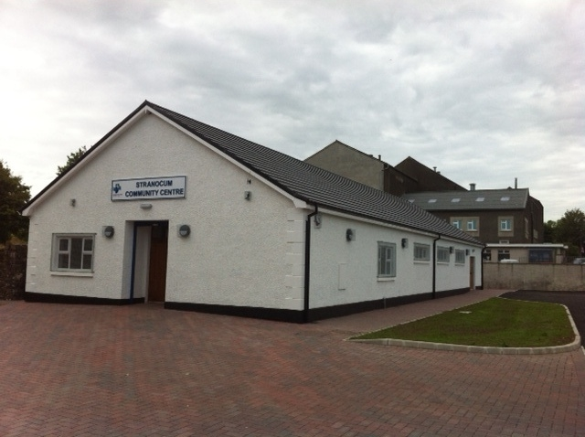
Strategic Framework for
Community Centre Provision:
Louise Scullion

Slide 38
Purpose To provide a process to proactively identify gaps in Community Centre provision across the Borough and to guide how Council works towards addressing gaps
Process: Identify and map the current supply of all facilities in an area/ Carry out an area profile/ Undertake a survey of users and potential users/ Assess each individual facility against Standards.
Prioritisation of support:
Level of deprivation; catchment population; local evidence showing demand; Range of services that will be delivered/facilitated in centre; Sustainability and governance of the centre ; Proactive engagement with wider community; Partnership approach

Slide 39
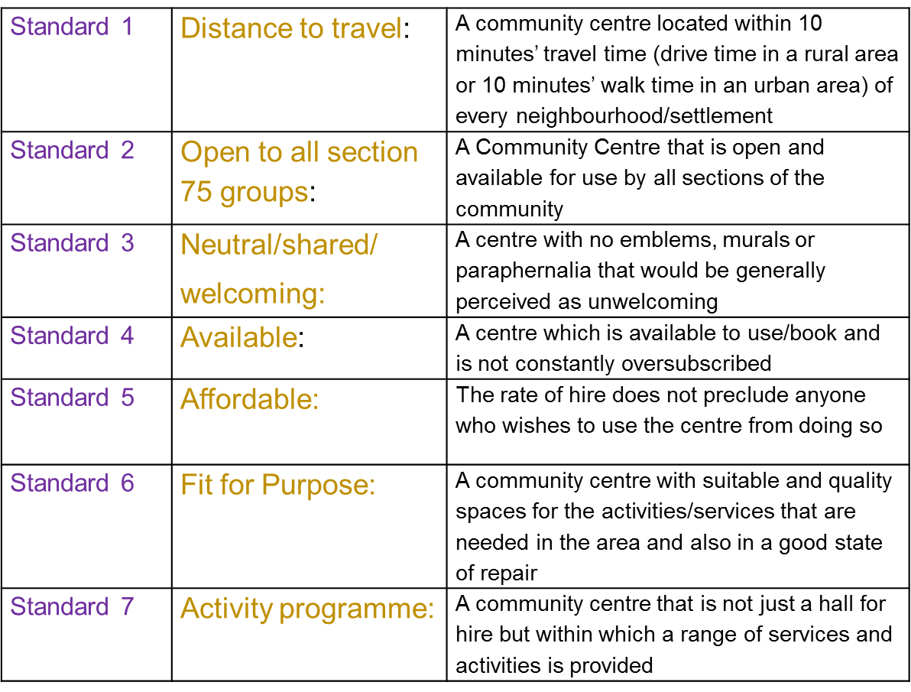
Standards for Community Centre Provision

Slide 40
Any Questions ?

